Slide 1

Delegates Assembly 2025
Online and International

Slide 2
123 Participants
73 Guests
50 Delegates
19 Countries
Argentina, Austria, Belgium, Brazil, Chile, Colombia, Costa Rica, Croatia, Dominican Republic, Ecuador, Germany, Ghana, Italy, Mexico, Portugal, Spain, Switzerland, United Kingdom, Uruguay
Delegates Assembly 2022

Slide 3
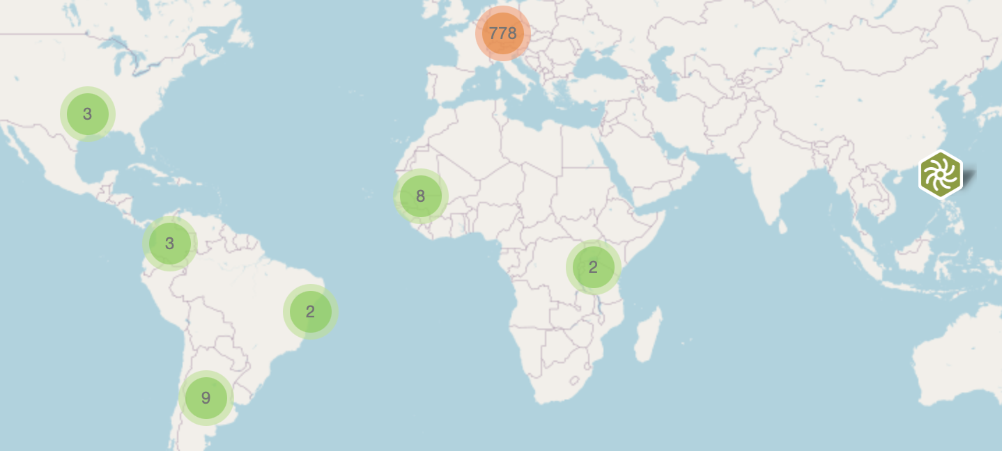
International Movement
Delegates Assembly 2025

Slide 4
Annual meeting of all Local Chapters, Hubs and Guests and a Gathering of ECOnGOOD activists from around the world.
Delegates vote on Strategic Issues
Delegates Assembly 2025
2013 Innsbruck
2014 Munich
2015 Munich
2016 Barcelona
2017 Paris
2018 Lisbon
2019 Stuttgart
2020 Online
2021 Online
2022 Online
2023 Online
2024 Online

Slide 5
Gain a deeper understanding of critical issues
Spread information to Hubs, Local Chapters and Associations
Network with other ECOnGOOD activists
Delegates Assembly 2025 - Goals

Slide 6
Role of the Delegates Assembly and ECOnGOOD Governance
Delegates Assembly 2025
Early on the DA was a central decision-making organ
Hubs became more an more important, Local Chapters spread around the world
National associations and in 2018 the International Federation were founded and took on most organizational functions
Today the DA is designed to bring the international movement together and make decisions on strategy and vision

Slide 7
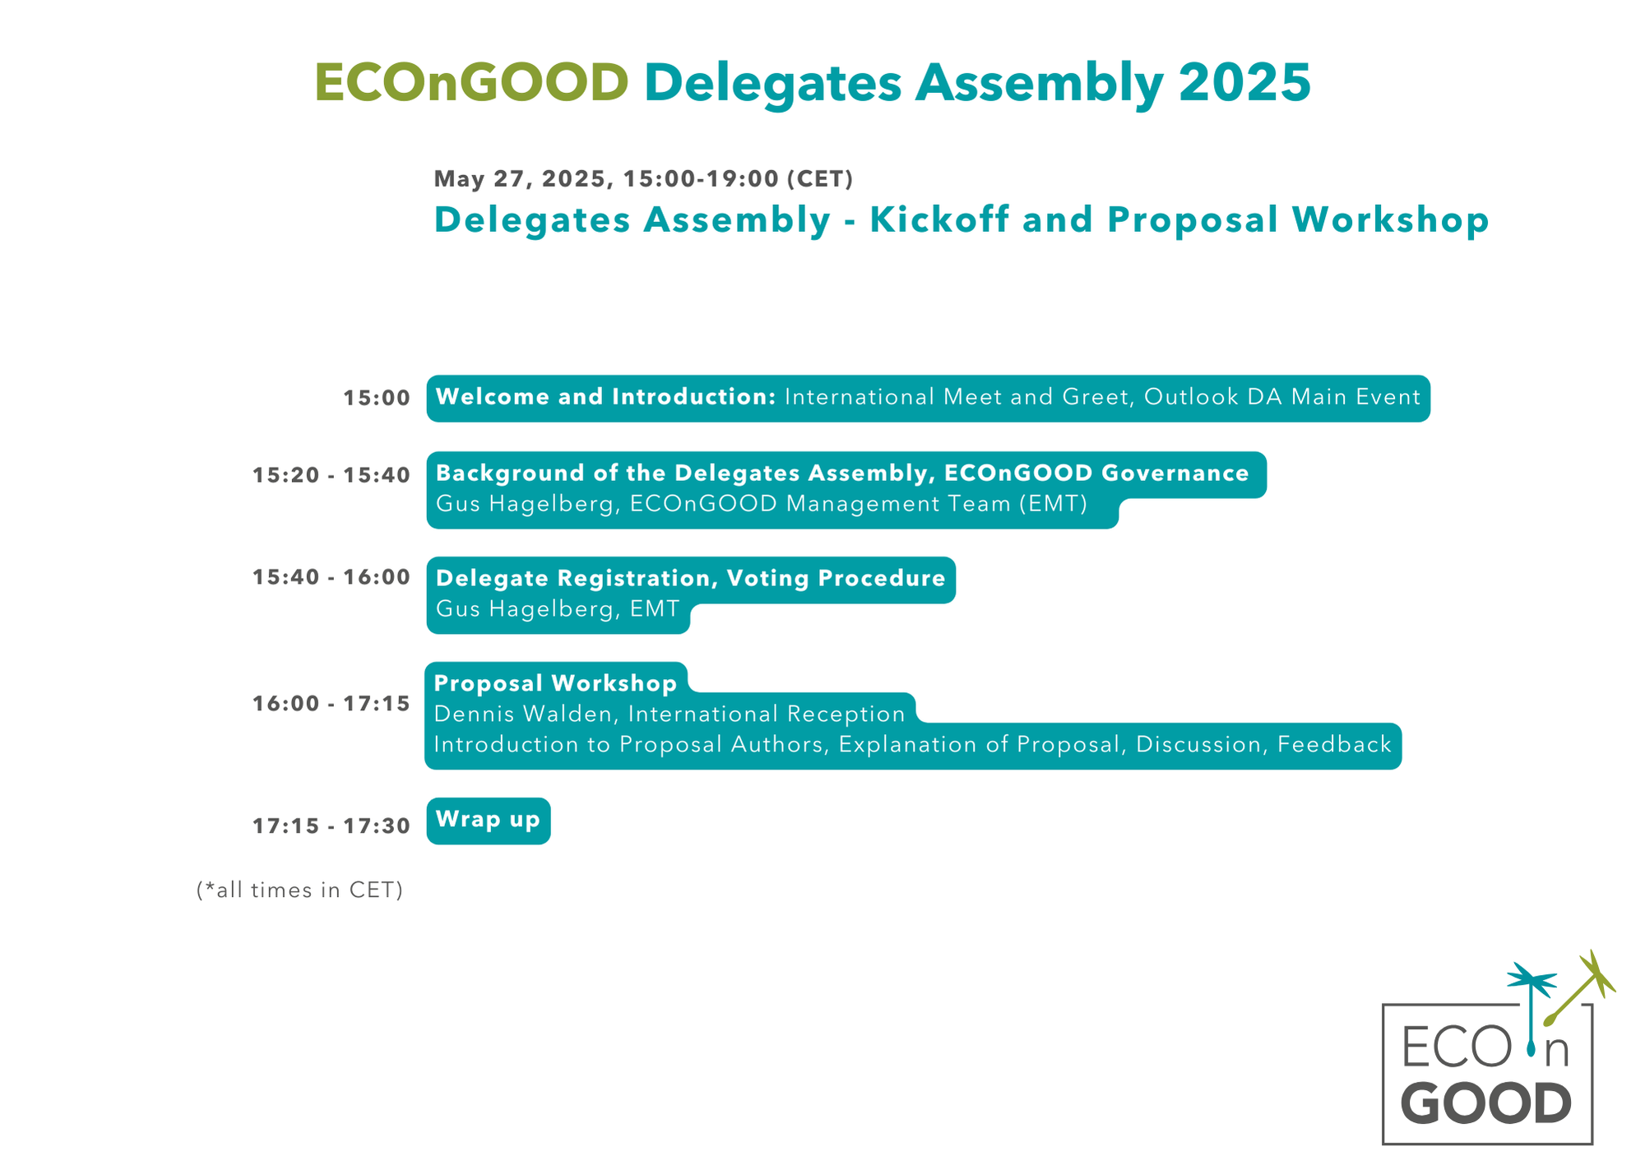

Slide 8
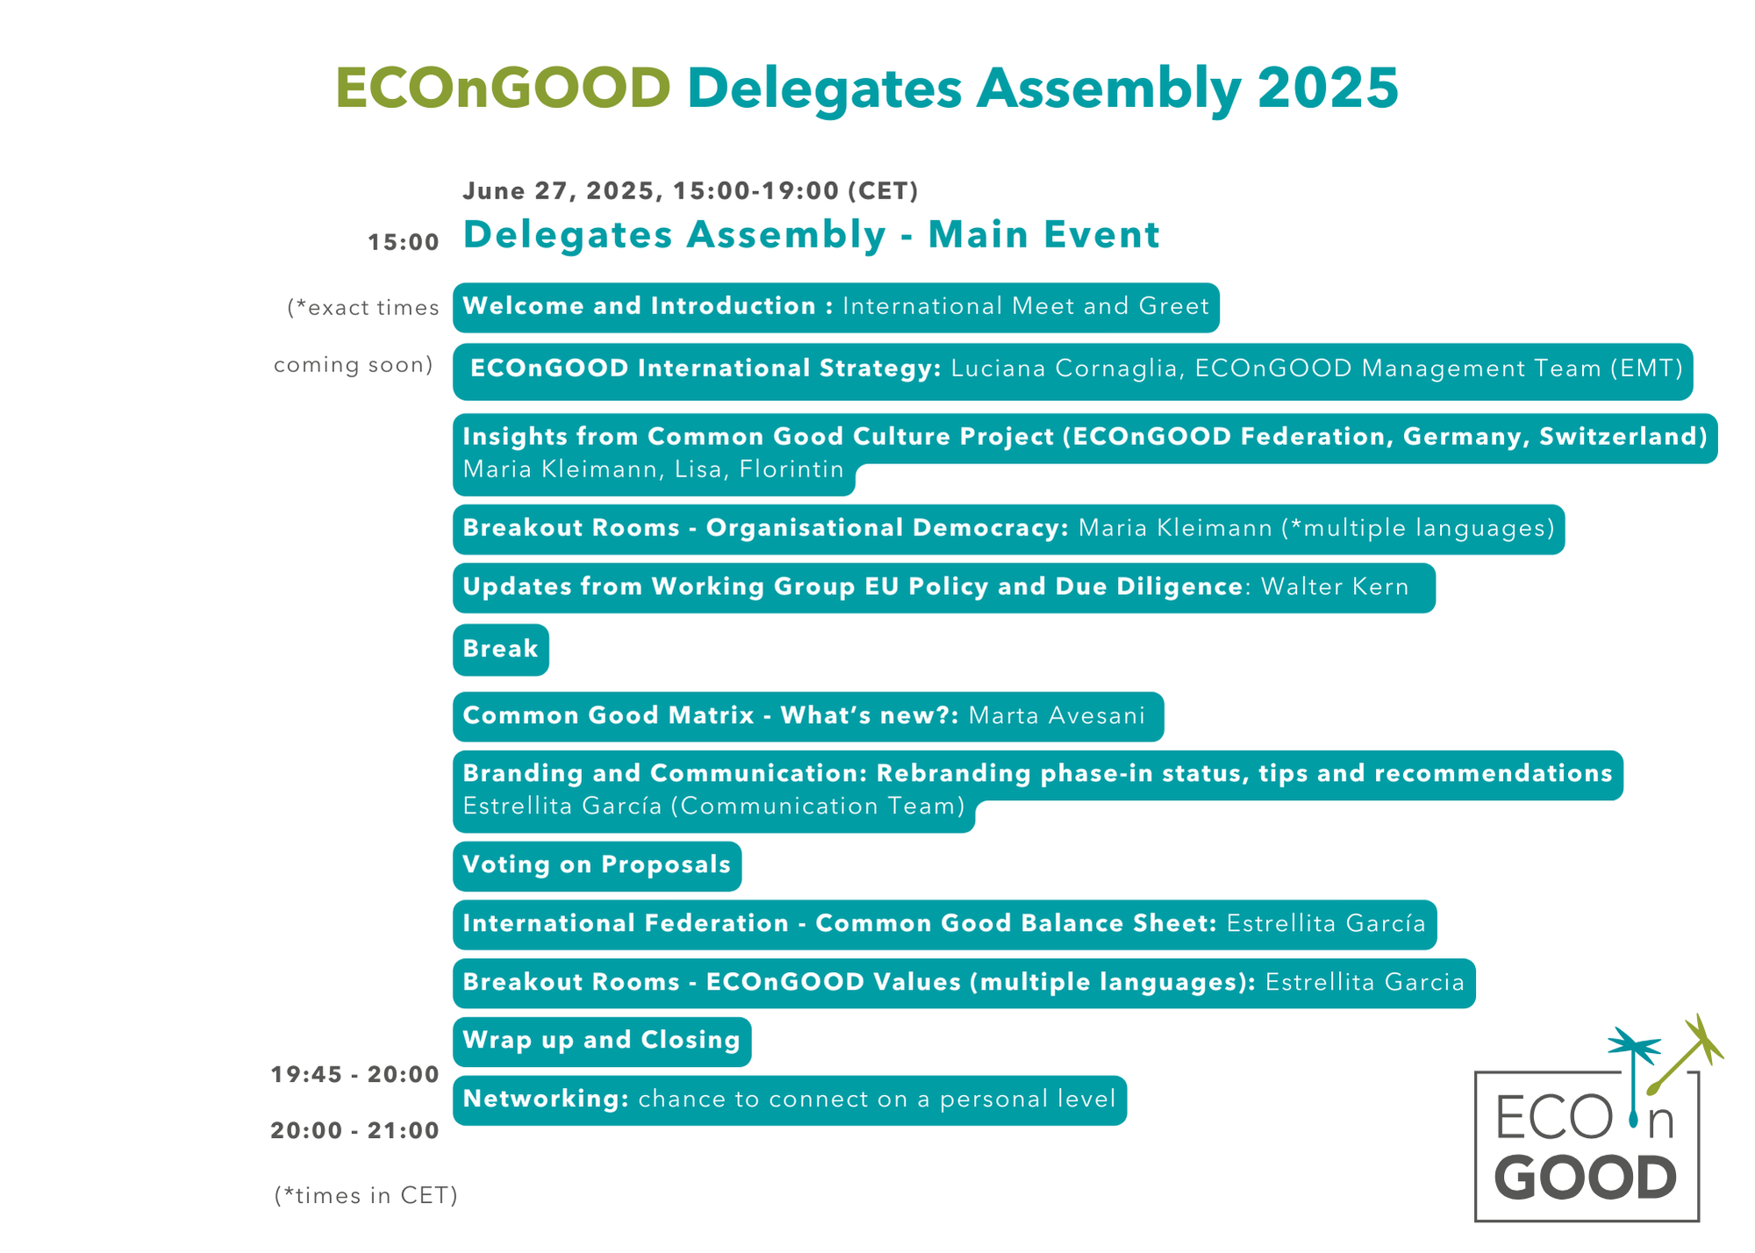

Slide 9
Proposals discussed in an online commenting phase
Proposal workshops provide time and space for delegates and guests to feedback directly and submit change requests
Proposals finalized two weeks before voting
Delegates will have ample time to read the final proposals and get feedback from their chapters or hubs
DA 2025 – voting and proposal process

Slide 10
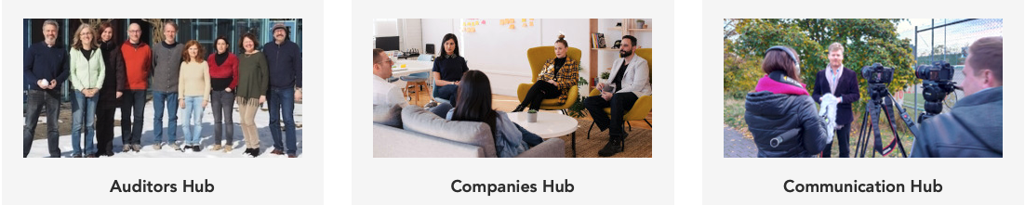
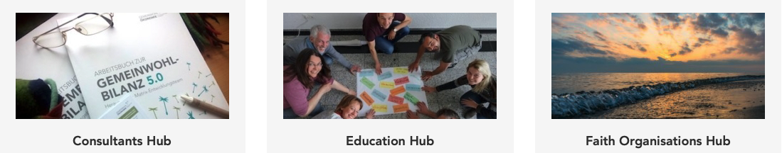

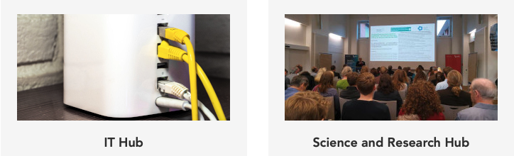
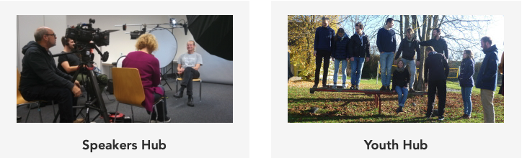
ECOnGOOD Hubs
permanent working groups dedicated to specific topics
international activities bringing experts together from the entire movement
Public Sector Hub

Slide 11
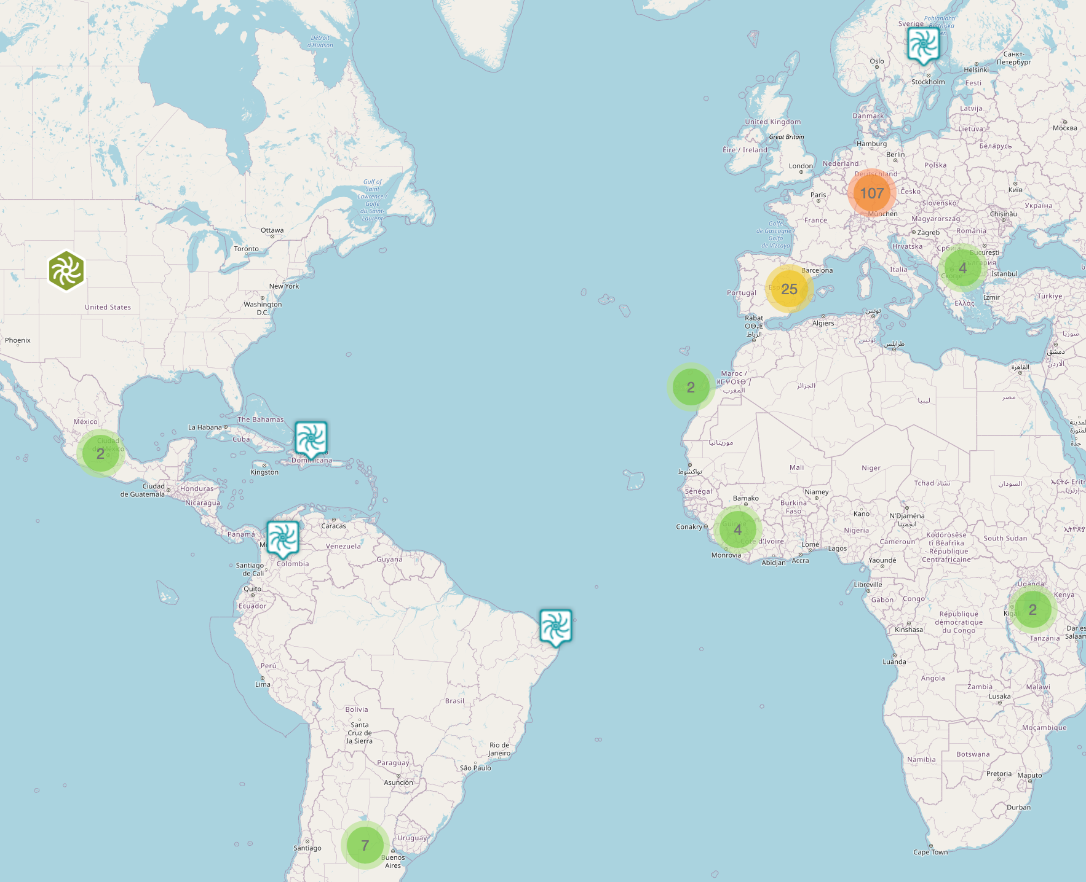
ECOnGOOD Local Chapters
Backbone of our movement
Activists organize local events, contact businesses and creating networks
Support Team for LC Coordinators in Germany, Austria, Switzerland and Italy
All are invited to join a chapter or create a new one
173 Local Chapters in 33 Countries

Slide 12
Hubs need to prepare their presentations for July 1
All participants can submit their ideas for Open Spaces
DA 2022 – Presentations and Open Spaces

Slide 13
Zoom – Online Meeting, Breakout rooms, Chat, Interpretations
Limesurvey – Voting
Email – Communication, Limesurvery Invitations
Wiki - Documentation
DA 2022 – Software Tools during DA

