Slide 1
EU Sustainability Reporting regulation
June 2024

Slide 2
The EU Corporate Sustainability Reporting Regulation is in force and gaining momentum.
Implementation into national law is imminent and the first companies have even (voluntarily) published their sustainability reports for 2023 in accordance with the new rules.
The good news at the beginning

Slide 3
Basic Understanding
Supporting Materials
Current Status and Outlook
Q & A
Agenda

Slide 4
1. Basic Understanding

Slide 5
EU Reporting Regulation - Interplay
CSRD (CSDDD)
EU Taxonomy Regulation - Definition of which economic activities are considered sustainable
SFDR (Sustainable Finance Disclosure Regulation) - Requirements for the disclosure of sustainability information in the financial sector
CSRD (Corporate Sustainability Reporting Directive) - Requirements for the disclosure of sustainability information in the real economy
CSDDD (Corporate Sustainability Due Diligence Directive) -
aka „EU Supply Chain Law“
SFDR
EU Taxonomy

Slide 6
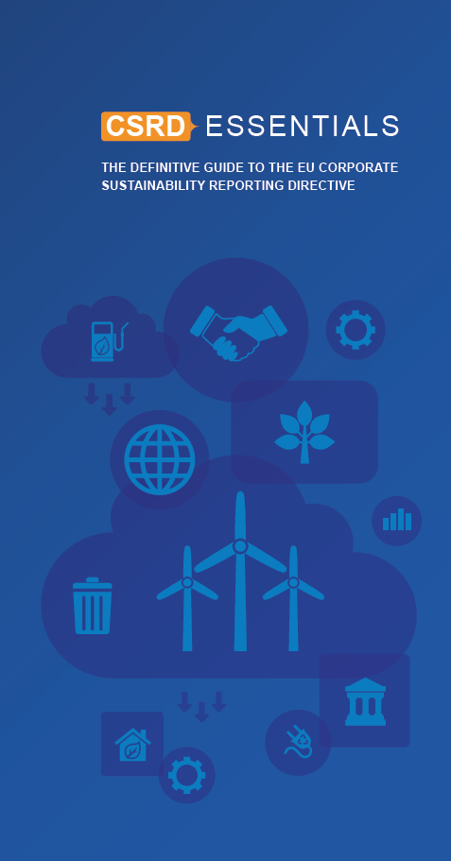
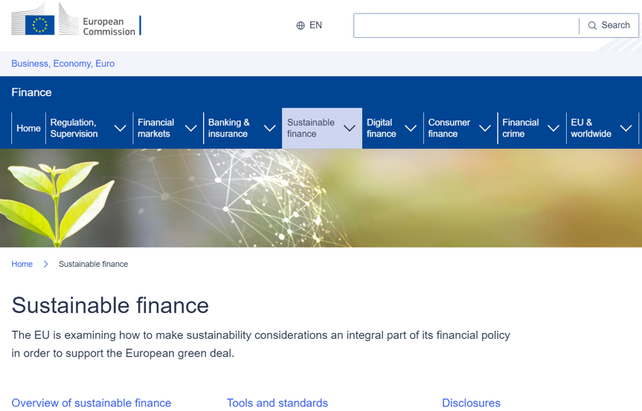
CSRD - Where to find information?
There is no lack of information.
However, the "single source of truth" is the EU Commission and the national CSR laws.
The "CSRD Essentials" publication provides a good overview.
https://www.globalreporting.org/CSRDEssentials

Slide 7
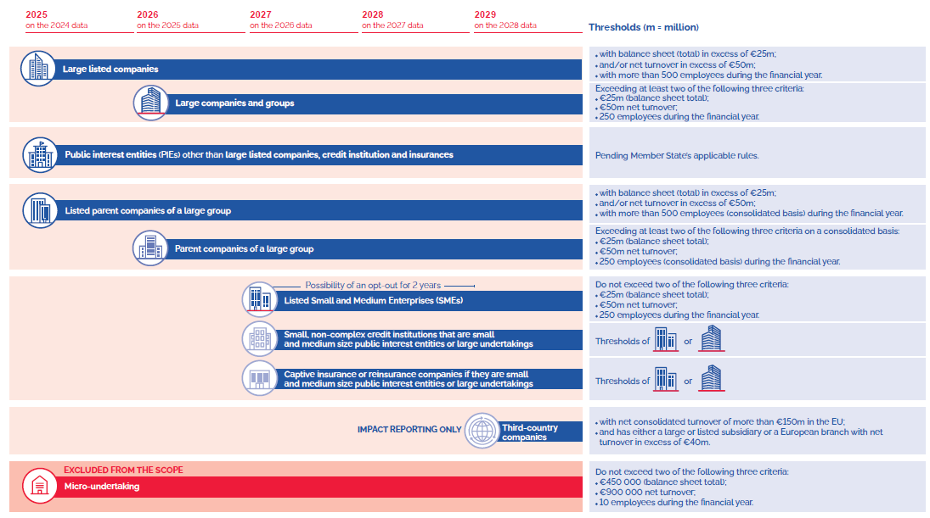
CSRD: Who and when?

Slide 8
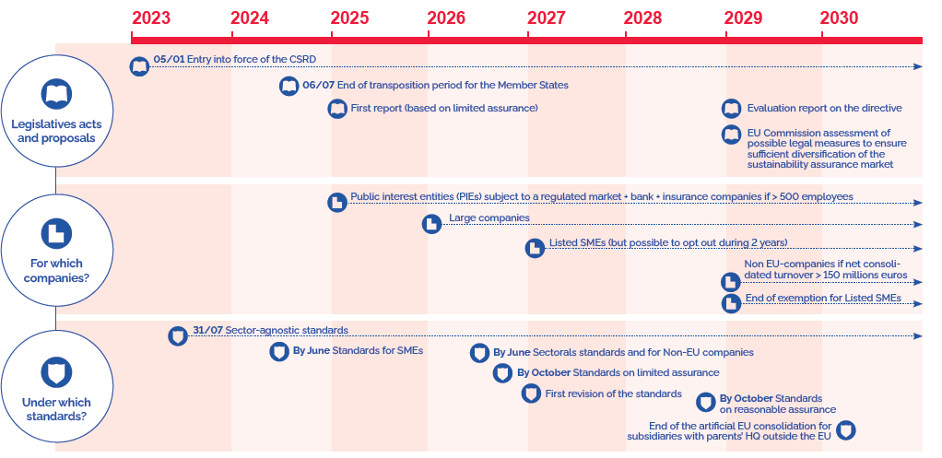
CSRD: What’s the timeline?

Slide 9
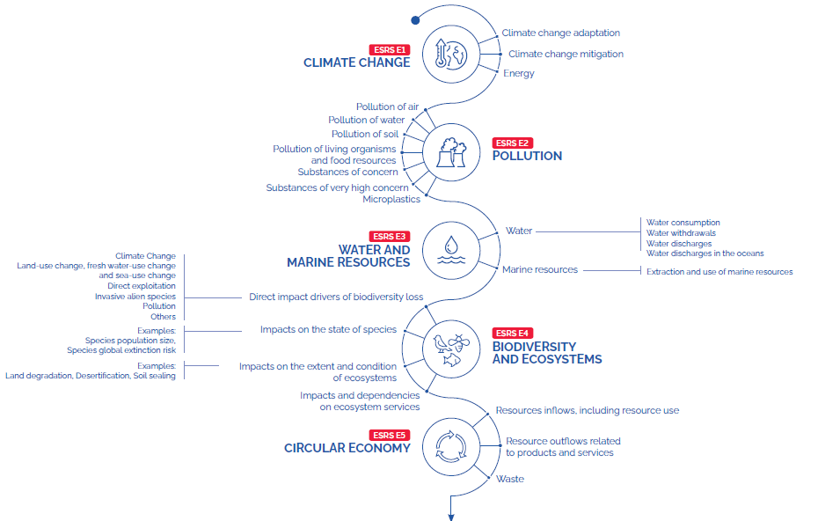
Sustainability matters covered in topical ESRS – 1/2

Slide 10
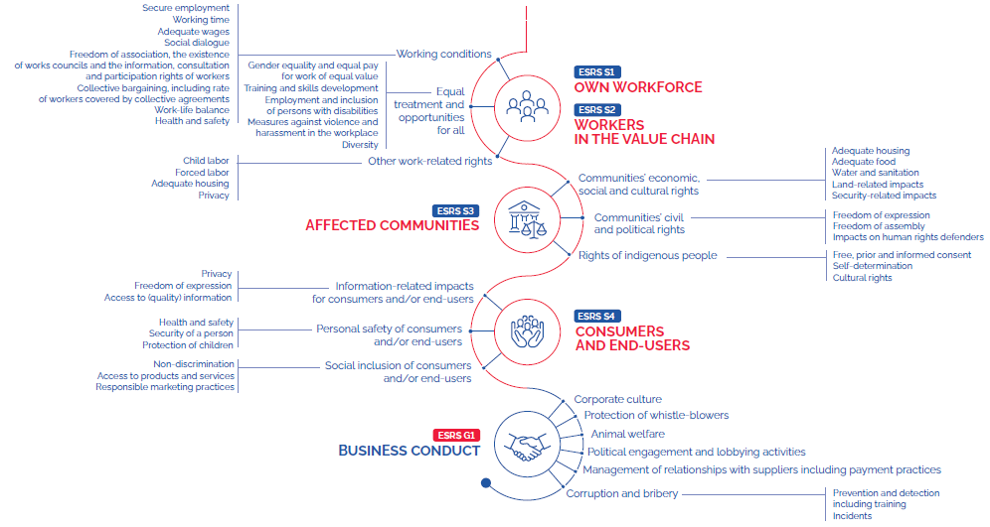
Sustainability matters covered in topical ESRS – 2/2

Slide 11
2. Supporting Materials

Slide 12
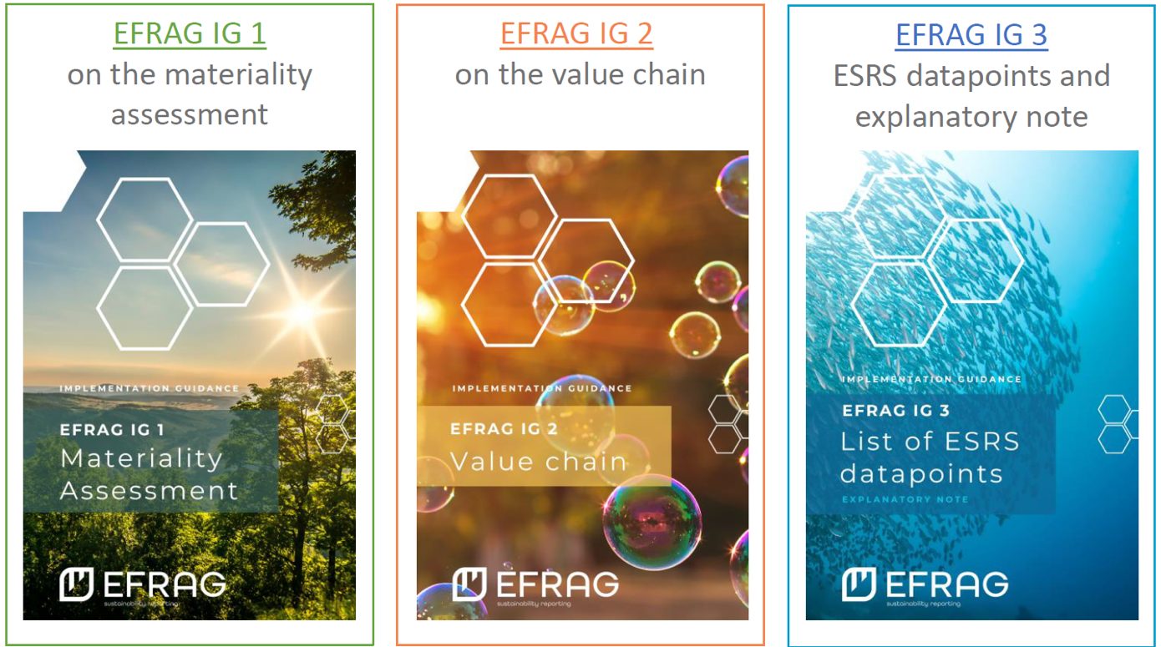
ESRS Implementation Guidance
EFRAG published the first three ESRS IG’s on 31 May 2024.
They are non-authoritative and support the understanding of
ESRS.
The approach or methodology illustrated is a possible way to implement the standard.
https://www.efrag.org/lab8

Slide 13

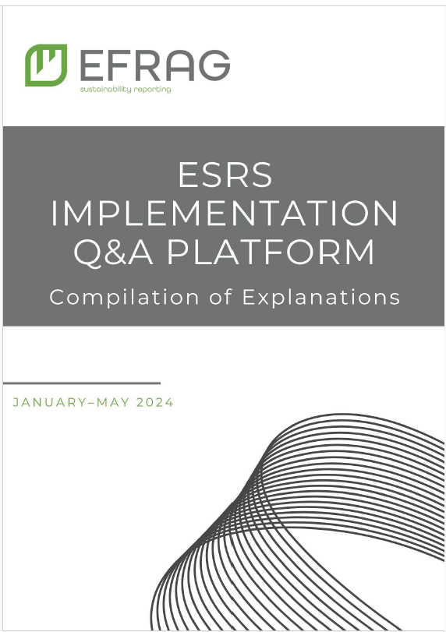
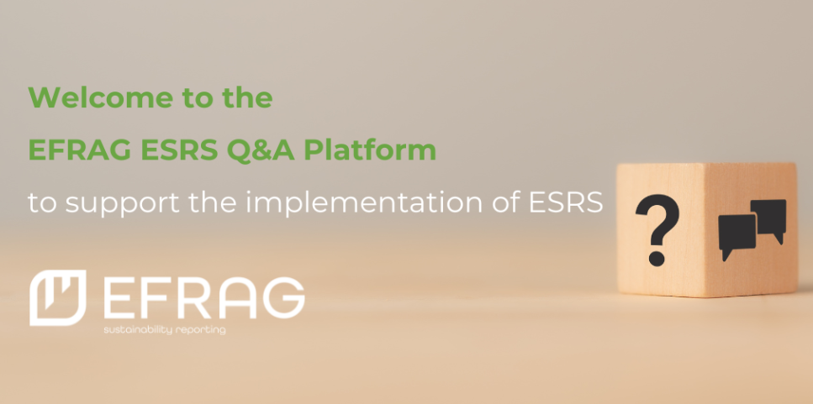
ESRS Q&A platform
The ESRS Q&A platform aims to collect and answer technical questions.
The first set of explanations was recently published.
https://www.efrag.org/lab7

Slide 14
3. Current Status and Outlook

Slide 15
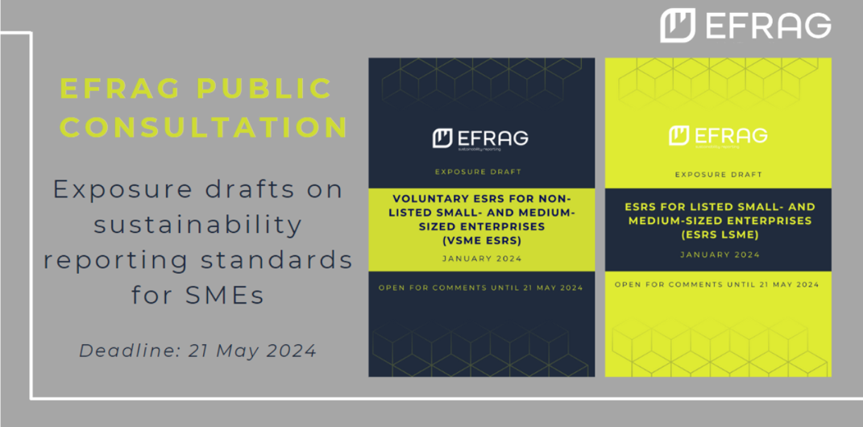
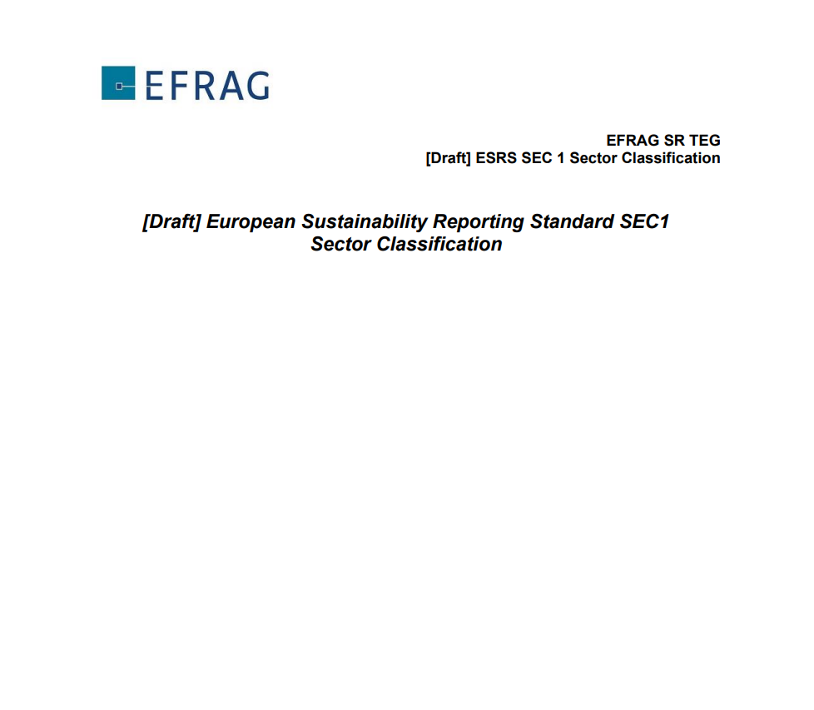

More to come…
- Standards for SME’s (LSME / VSME)
- Digital Taxonomy (XBRL / ESEF)
- Up to 40 Sector Standards
- Standard for Non-EU-Companies
- Standards on limited / reasonable assurance
- Different reports (i.e. evaluation report on the directive)
EU Sustainability Reporting Regulation | www.ecogood.org |

Slide 16
Q&A

Slide 17
THANK
YOU!
walter.kern@ecogood.org | www.ecogood.org

