Slide 1
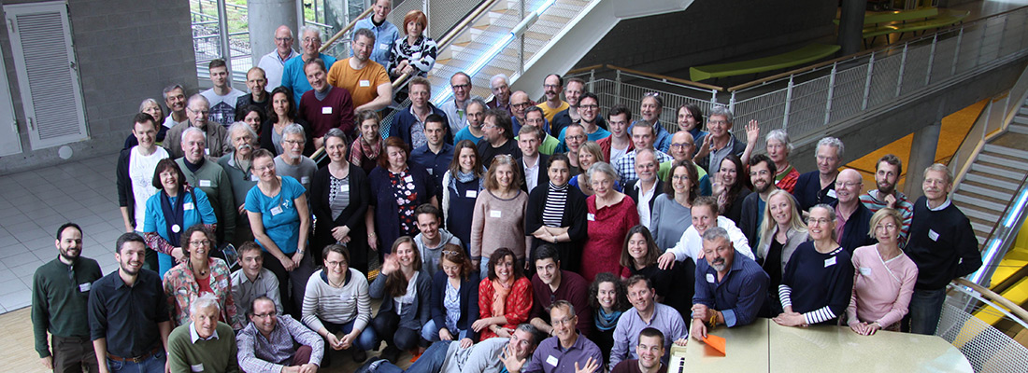
ECG DELEGATES ASSEMBLY
PROPOSALS
1
Submission and review of proposals from across the movement
Proposal workshops and revisions leading up to the voting at the Delegates Assembly
Delegates are accountable to ensure a full understanding of the proposals before voting
Only delegates have voting rights
Notes:
Each year there is a call for proposals.
Chapters, Hubs can submit proposals to the Delegates Assembly
Chapters and Hubs nominate a delegate to vote on their behalf and to represent the collective view of the group.
These nominated delegates will be voting on each of the proposals and it is their responsibility to make sure they are fully accountable for understanding the proposals before voting.
During the delegates assembly, the voting will take place on the submitted proposals
For each proposal, delegates have the option of voting once
Please note that only delegates can vote, guests are welcome to participate at the assembly but are not eligible to vote.
This year we have 4 proposals for consideration

Slide 2

ECG DELEGATES ASSEMBLY
VOTING – Sovereign Democracy
2
The voting procedure we use within the ECG Delegates Assembly is Sovereign Democracy
A method developed by the University of Graz
Notes:
Sovereign Democracy
The voting process we use within the ECG is sovereign democracy
This is a method developed by the university of Graz
Scholars at the university realised that every rule (existing or alternative) restricts the liberty of citizens and causes pain in the population
This procedure from the University of Graz, finds the rule that causes the least pain in the overall population and restricts liberty in the least possible degree

Slide 3


ECG DELEGATES ASSEMBLY
VOTING – Sovereign Democracy
3
This procedure finds the rule that causes the least pain in the overall population
and restricts liberty in the least possible degree
What will cause the least pain?
Notes:
In order to assess the level of pain…
Delegates don’t show their affirmation or agreement but instead show their level of resistance against every single proposal

Slide 4

ECG DELEGATES ASSEMBLY
VOTING – Sovereign Democracy
5
First you listen to the proposal, then listen to your heart
You can close your eyes, check to see if there is any pain
Notes:
Basically when voting, there are three options to show your pain and your resistance
First you listen to the proposal, then listen to your heart, you can close your eyes to connect with your intuition
Sense whether there is any resistance, is there any tension or pain.
How much resistance can you feel?

Slide 5
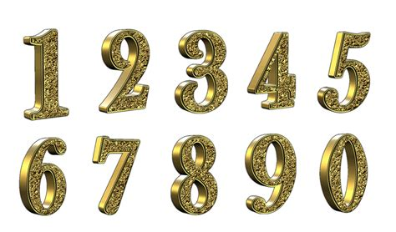
ECG DELEGATES ASSEMBLY
VOTING – Sovereign Democracy
6
You have three options to show your pain and your resistance
No pain = no resistance
Some pain = some resistance
Strong pain = strong resistance
0 = agree
accept the option
1 = partial agreement
can live with it
2 = opposed
reject this option
Notes:
There are three options to show your pain and your resistance
If there is no pain, there is no energy for resistance and you should vote “agree”
If there is some pain some resistance, you declare “partial agreement”
If there is strong pain, there is a lot of energy for resistance, then you vote “opposed”

Slide 6

ECG DELEGATES ASSEMBLY
VOTING – Sovereign Democracy
4
Only registered delegates may vote on the proposals
Delegates can vote by sharing their level of resistance to each voting option
Notes:
All delegates have a chance to vote today.
Voting is by name / Results will only be shown in a generalized manner
Delegates will receive an email with the individual link to the lime survey
Voting will be open during a specified period of the DA
Delegates can save, change and resubmit their votes at any point during the voting period until a specified time
The voting submitted, when the polls are closed will count as their final vote

Slide 7
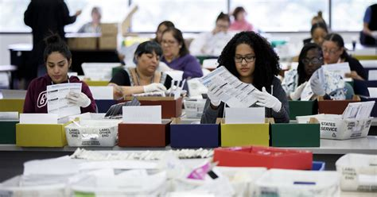
ECG DELEGATES ASSEMBLY
VOTING – Sovereign Democracy
7
All the votes are then counted
The proposal with the least resistance goes through
Notes:
All the votes are then counted and the proposal with the least resistance goes through.
If there is strong resistance to any proposal and each of it’s alternatives, then the proposal is not passed.
Voting results will bepublished on the second day of the DA
Link to Ted Talk by Christian Felber: https://www.youtube.com/watch?v=dsO-b0_r-5Y
Limesurvey

Slide 8
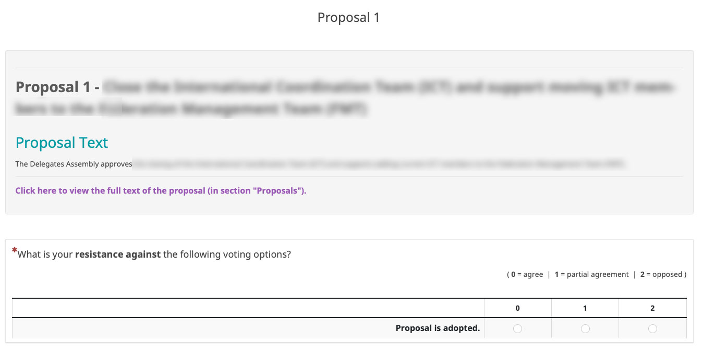
ECG DELEGATES ASSEMBLY
VOTING – Sovereign Democracy
8
Proposal voting remains open until 22.00 (CEST)
When polls close, the submitted votes will count as the final vote
Delegates will receive two emails with access codes for the voting
Voting results will be published the following day
Notes:
Here is an example of the limesurvey voting template.
There are at least 2 rows for the options
1) You will be asked if you wish to reject the proposal
2) If you wish to accept the proposal with no changes
Then there may be additional options if there are alternatives or variants to the main proposal. One for each variant if applicable
There are always 3 columns to express your resistance against any of the options
0 = agree, accept the option
1 = partial agreement, can live with it
2 = opposed
If you wish to abstain from voting, please indicate 0 = agree on all voting options to show that you delegate the decision to the other voters in the process.
It is mandatory to give resistance points to each option. Otherwise you can not proceed to the next proposal / question.

