Slide 1
EcoGood in Luxemburg

Slide 2
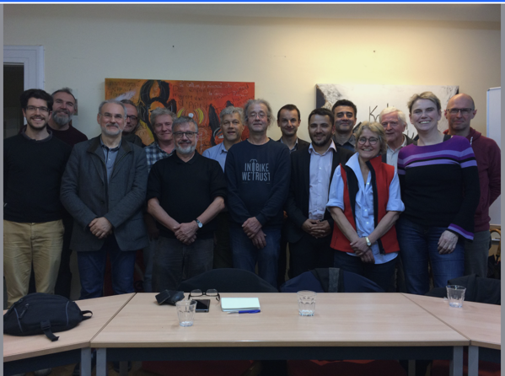
ECG in Luxembourg -
Gemeinwohlökonomie Luxembourg asbl
Founded in 2019
starting slowly to promote the idea of the economy for the common good; exchanges with companies, society and politics
organising membership structure
establishing the relation to the international movement
conferences, first peer group
www. luxembourg.ecogood.org

Slide 3









Growing network in Luxembourg

Slide 4
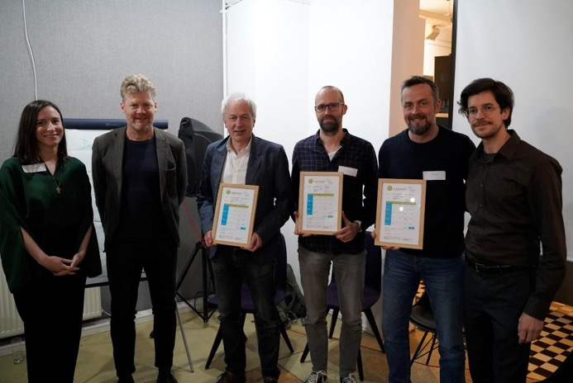
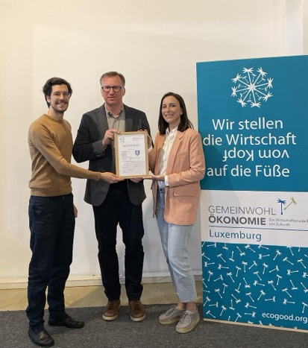
PRESENTATION of CERTIFICATES
ENERGIEPARK REIDEN
GREENPEACE
NATURBAUSTOFF
CITY OF DIFFERDANGE
moderated by Lara Frisch and Gregor Waltersdorfer

Slide 5
Results Matrix Greenpeace Luxembourg
VALUE | HUMAN DIGNITY | SOLIDARITY AND SOCIAL JUSTICE | ENVIRONMENTAL SUSTAINABILITY | TRANSPARENCY AND CO- DETERMINATION
STAKEHOLDER
SUPPLIERS | A1 Dignité humaine dans la chaîne d'approvisionnement 30% | A2 Solidarité et justice sociale dans la chaîne d'approvisionnement 40% | A3 Durabilité environnementale dans la chaîne d'approvisionnement 40% | A4 Transparence et co-détermination dans la chaîne d'approvisionnement 10%
OWNERS; EQUITY AND FINANCIAL SERVICE PROVIDERS | B1 Position éthique par rapport aux ressources financières 60% | B2 Position sociale par rapport aux ressources financières 90% | B3 Utilisation de fonds par rapport aux impacts environnementaux 90% | B4 Propriété et co-détermination 20%
EMPLOYEES INCL. CO-WORKERS | C1 Dignité humaine sur le lieu de travail et l'environnement de travail 60% | C2 Arrangements de travail autodéterminés 60% | C3 Comportement respectueux de l'environnement du personnel 80% | C4 Co-détermination et transparence au sein de l'entreprise 60%
CUSTOMERS AND OTHER COMPANIES | D1 Relations avec la clientèle éthique 50% | D2 Coopération et solidarité avec d'autres sociétés 70% | D3 Utilisation et élimination environnementales des produits et services 40% | D4 Participation des clients et transparence des produits 50%
SOCIAL ENVIRONMENT | E1 Le but des produits et services et leur effet sur la société 80% | E2 Contribution à la société 30% | E3 Réduction de l'impact environnemental 10% | E4 Transparence et co-détermination à d'autres parties prenantes pertinentes 30%
 |  |  | certificate valid until: | TOTAL: 507.5 of 1000
Average
30%
65%
80%
53%
38%
Notes:
nombre total de points
élements

Slide 6
Main conclusions (1/2)
Suppliers:
Initial Screening: We have procedures to assess suppliers upfront, but ongoing monitoring of their environmental and social impact is limited.
Limited Selection: Choosing suppliers in line with Ecogood criteria can be challenging in some areas, like social media platforms.
Owners, Equity and Financial Service Providers:
Strengths: We perform well in meeting Ecogood criteria for these stakeholders.
Opportunities: We can explore co-determination practices for greater stakeholder involvement.
Employees (including co-workers):
Inclusive Workplace: We promote a diverse workforce and support employee development.
Work-Life Balance: We offer flexible work hours.
Collaborative Culture: While we encourage consensus decision-making, implementation can be improved.
Notes:
owners, equity and fin. services : financing of activity
Suppliers :
Upfront controls (procedures in place) of suppliers BUT no continuous assess of their impacts
Not always possible to choose our suppliers (for example : social medias)
Owners, equity and financial service providers :
Good results regarding the ecogood criteria
Room to improvement : co-dermination
Employees incl. co-workers :
Diversity in our staff + self-development is encouraged
Flexibility in the working hours
Consensus is promoted but not always implemented

Slide 7
Main conclusions (2/2)
Customers (supporters, donors):
Direct Engagement: We directly connect with our supporters (those who follow and contribute to us).
Collaborative Action: We value collaboration and solidarity with our supporters in certain initiatives.
Social Environment:
High-Quality "Goodies": The "goodies" we offer in exchange for contributions meet high environmental and social standards.
Minimized Footprint: Our operations have a low environmental impact.
Continuous Improvement: We are committed to finding new ways to further reduce our environmental impact.
Notes:
Customers and other companies :
“Customers” for GP Lux are the people that follow & support us
GP Lux is in direct contact with them
Collaboration is important for GP : solidarity in some action
Social environment :
“Products” for GP Lux are the “goodies” that we are giving in exchange of a contribution : high standards set
Small environmental impact of our activity
Still no defined strategy to reduce our impact even more

Slide 8
Challenges and opportunities
Challenges :
Demanding Process: Completing the Ecogood report requires significant effort.
"Harsh" Results: Scores shows seems to be low initially, despite positive efforts.
Example: Low score in E3 (social environment/environmental sustainability) due to lack of a specific reduction plan (even if impact is limited).
Data Challenges:
Difficulty gathering and providing granular data.
Questions and indicators may not perfectly align with NGO activities (e.g., no clients, providers, or sales).
Opportunities :
Improved Practices and external communication : The report can identify areas for improvement in data collection and communication with stakeholders.
Positive Change: A springboard for implementing changes in working habits and information management.
Notes:
Ecogood report is a demanding process
“Harsh” results BUT having 30% is already considered as “advanced”
For example : topic E3, social environment/ environmental sustainability, we don’t have any specific plan to reduce our impact even though it is limited or not entirely into our hands → low points
Good to have help & exchange with other organisations and specialists to answer the questions and complete the indicators
Not always ready or able to communicate the information (data gathering, granularity…)
Good starting point to impulse changes in our working habits and information/data gathering and exchange with our stakeholders
Questions and indicators are not always perfectly fitting specific activities of NGO organizations
→ e.g. we don’t have clients and not much providers. We are not selling anything.

Slide 9
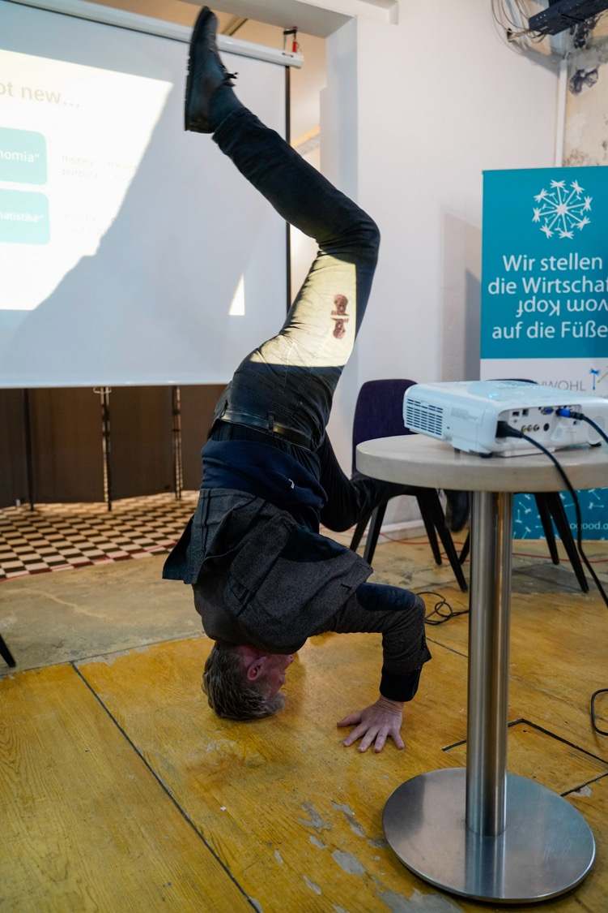
THANK
YOU!
raymond.aendekerk@ecogood.org
luxembourg@ecogood.org
www.luxembourg.ecogood.org
www.ecogood.org

