Slide 1
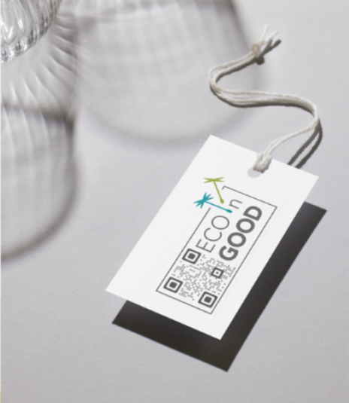












ECOnGOOD
NEW| Label and Branding
Notes:
Very different levels of knowledge, I will try to fulfill everyone’ needs. Answer questions.
Project great milestone for movement. Adoption by many, positive feedback
Thank you to great team

Slide 2
01 Initial Situation
02 Branding
03 Label
04 Network Signs
05 Introduction Rebranding
content
Notes:
Go through relatively quickly

Slide 3
Initial Situation
01

Slide 4










Terminology | Logo vs. Label
What‘s A logo?
A logo is a graphic symbol that represents a specific subject, which can be a company, an organization, a private person or a product. It can be designed as a pure figurative mark, word mark or word-image mark and is the essential component of the visual appearance (corporate design) as well as a carrier of the identity (corporate identity) of the rights holder.
This is referred to as branding.
WHat‘s A label?
A label can be a quality, test, origin or environmental mark. A typical label can be found in every piece of clothing (fashion label) or in the labeling of services and food. A label provides orientation regarding the characteristics and quality of a product or service. It is subordinate to the logo, differentiates itself from it, but does not compete with it.
Often also referred to as seal.
Notes:
Logo on printed material such as letterhead, business cards, flyers etc. On website, social media. Our distinguishing feature
Label is the EOnGOOD quality mark, graphic expression of the quality of the company / product

Slide 5

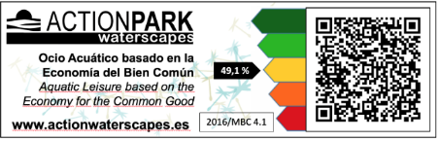








Status Quo | Labels
Notes:
Due to lack of an official label many have been created: just a small selection

Slide 6

Timeline | Milestones and Information at Meetings
Founding of Project Team
Workshops ¹
DA Decision ²
Naming Process ³
Decision for ECOnGOOD
Trademark ECOnGOOD
Launch of Pilot Phase
Trademark Seedlings
Launch at
BIOFACH
Q4
2019
Q1
2020
Q2
2020
Q3
2020
Q4
2020
Q1
2021
Q2
2021
Q3
2021
Q4
2021
Q1
2022
Q2
2022
Q3
2022
Q4
2022
Q1
2023
Q2
2023
Q3
2023
Q4
2023
Q1
2024
Comms Hub
Comms Hub
Comms Hub
Comms Hub
Comms Hub
Staff
Comms Hub
Comms Hub
Comms Hub
Comms Hub
Comms Hub
Comms Hub
Comms Hub
FMC
Hub Coordination
DA Info
on Status
Hub Coordination
FMC
FMC
FMC
FMC
FMC
Staff
Hub Coordination
Staff
Staff
LC Support Team
Hub Coordination
Hub Coordination
DA Info
on Status
Audit Hub
Hub Coordination
DA Info
on Status
Consultants Hub
Sommerwoche
MDT
Info Session ES
LC Support Team
Info Session IT
DACH Consultants Hub
Staff
Info Session International
¹ with ECG Auditors, Consultants, Organizations, IT as well as experts for graphic-design, brand development, branding, marketing, QR Code, labeling and packaging design
² a uniform international logo and label for organizations with a Common Good Balance Sheet shall be developed
³ 23 participants from 14 nations
Consultants Hub
Info Session DACH
Companies Hub
Staff
Audit Hub
FMC meetings
DA
All other meeting
Notes:
All meetings announced by email, infos in newsletters, EMT
Q3 2022: alle Hubs
2023 Info Sessions: DE, EN, ES
Launch 15. Feb. 24 BioFACH Nuremberg

Slide 7
This is one of the reasons why we do not achieve the desired and necessary awareness.
To create real impact, we need the external perception as an international organization and as a visually present brand.
It is essential that we can quickly and easily adapt all communication material for all languages.
We are not being recognized as one organization
Notes:
Frequently active members complain about lack of publicity. Think of other organizations: Bcorp, Greenpeace, WWF, Unicef - clear distinctive visual language.
Not only adapt for vasious languages but even regions

Slide 8
Status Quo
Our current name is a designation for an economic model: The term Common Good is generic, cannot be protected, and is widely used. It is not a name in the sense of trademark law.
There are parties who use the term Common Good for themselves, who have absolutely nothing to do with the Economy for the Common Good
Over the years, a variety of logos and icons have evolved. Between different countries and even within each country, depending on their use.
Notes:
Reichsbürger, extreme right in DE and CH
https://wiki.ecogood.org/x/DgCjGw

Slide 9
Since we have been using the URL
ecogood.org
for many years, that would be the obvious name.
However, this brand belongs to a Berlin-based company.
Negotiations with this company did not lead to success.
Ecogood is NoT AN Option

Slide 10
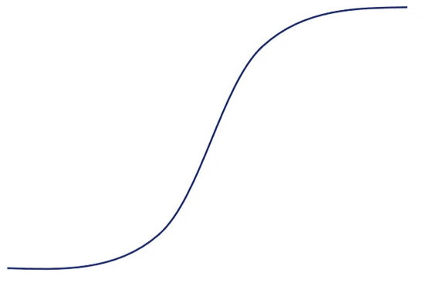


Market Maturity | We are in Puberty
Children should receive two things from their parents: Roots and wings.
―Johann Wolfgang von Goethe
Phase I
Introduction
Phase II
Growth
Phase III
Maturity
Phase IV
Saturation
Phase V
Degeneration
ECOnGOOD Introduction Branding and Label
10
Notes:
14 years old
Org Development: Puberty, leave roots, spread wings, changes in org in general
Not well known, in BaWü maybe every 100., in Saxony every 1000., in Switzerland every 100.000, in Australia every 10 millionth
if we want to go up the curve, we need uniform recognizability
Change Logo: Mercedes, Adidas
Change of Name: Twitter – X, Raider – Twix

Slide 11
Branding
02
Notes:
A Logo is a graphic Symbol (Signet), that represents a certain subject, which can be a company, an organization, a private person or a product. This is referd to as branding

Slide 12

The Soluion | Branding
ECOnGOOD stANDS FOR
ECONOMY and GOOD
ECO and GOOD
Good Economy
Advantages
Natural evolution of the existing branding
Applicable internationally
Easily recognizable even in small print size
The seedlings are unchanged
The colors are kept
The font remains the same
ECOnGOOD Introduction Branding and Label
Notes:
Name created at a large meeting Aug. 2020 (23 participants from 14 nations), then Q3 2021 Call for proposals, registered Q1 2022.

Slide 13

Logo | Various Designs
Notes:
Complete Branding Package in Wiki
https://wiki.ecogood.org/x/uIDnGQ
Branding FAQ
https://wiki.ecogood.org/x/YoDnGQ

Slide 14
Label
03
Notes:
Based on CGBS. Thus label for entire company, of course also NPO such as Greenpeace, Caritas
Don’t examine individual product, but entire organization with 360 degree view, not only aspects of sustainability, but also social, ethical aspects, such as interactions with employees, suppliers and other companies

Slide 15
The idea of comparability and awareness of companies with an ECG Balance Sheet has been a cornerstone for the success of the idea of the Economy for the Common Good from the very beginning.
We want to expand beyond the social-ecological sphere and be recognized as a standard for values-based economics.
We need communicative added values for organizations in the context of mandatory CSR reporting in order to succeed in the competition of CSR standards.
Consequence | Label
Notes:
Label was part of the basic idea from the very beginning

Slide 16

The Label
Completely new approach
Considers societal, ethical and environmental factors
Proves that it is possible to promote fair and responsible business practices
Properly assesses the real impact of operations and supply chains
Empowers stakeholders to make better choices aligned with their needs and values
Notes:
Completely new approach that takes social, ethical and environmental factors into account
And thus proves that it is possible to promote fair and responsible business practices
Because the actual impact of business activities and supply chains is properly assessed
All stakeholders are empowered to make better decisions that are in line with their needs and values.

Slide 17

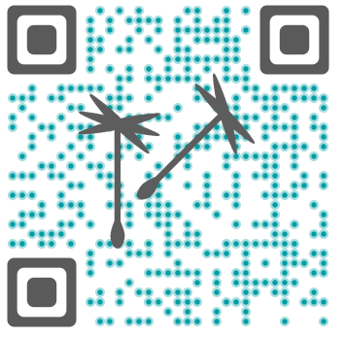
Label | Elements
FULL version
Whenever possible, the label should be used in ECOnGOOD’s corporate colors with a QR code.
This label is supplied as: eps, jgp (for printing and web), png
It may be used as a two color graphic: white and black, ECOnGOOD‘s corporate colors, the green of the European organic food label
SPACE LIMITATIONS
On some packages, organizations may not have enough space for the entire label. In these cases, the QR code can be used without the addition of ECOnGOOD.
To add recognition and draw attention this graphic is designed in ECOnGOOD’s blue with the seedlings in grey.
Minimum space requirement 1,4 cm²
Notes:
Other size or color requirements: Support from org‘s graphics team or else contact us

Slide 18
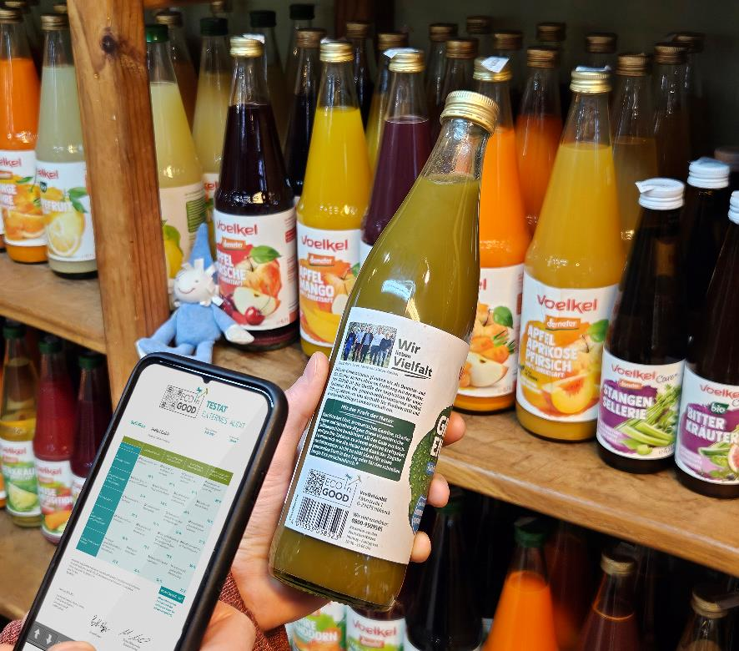
The QR-Code | Usage
Easy to use for consumers
Full transparency
Significantly more information than normal seal
Applicable for all companies and products
Notes:
Making shopping easier for consumers
Decision can be made at the shelf in the store to buy a more sustainable, ethical product

Slide 19
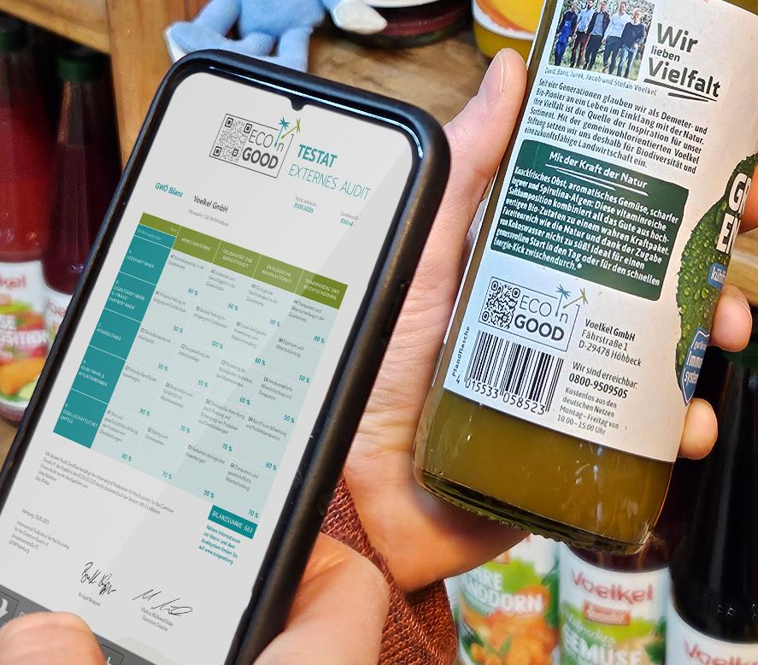
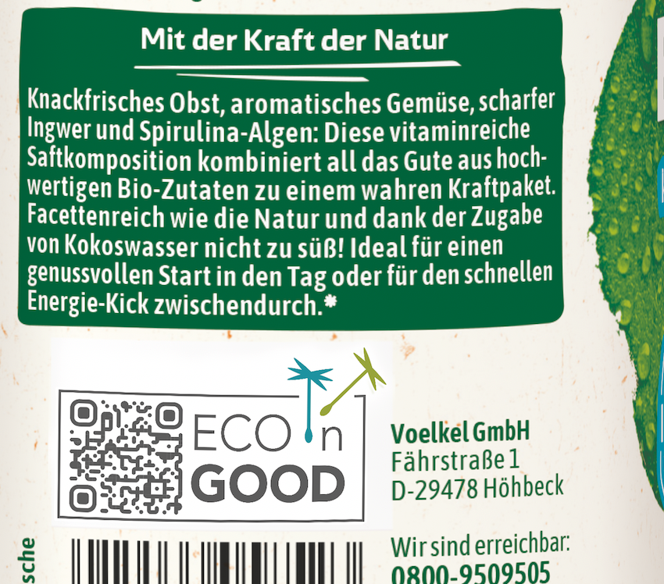
The QR-Code | Transparency
Notes:
You can try it right now
Usage of modern technology
Label with QR Code on product
QR Code of the Label leads directly to result of CG-Balance of the respective org

Slide 20
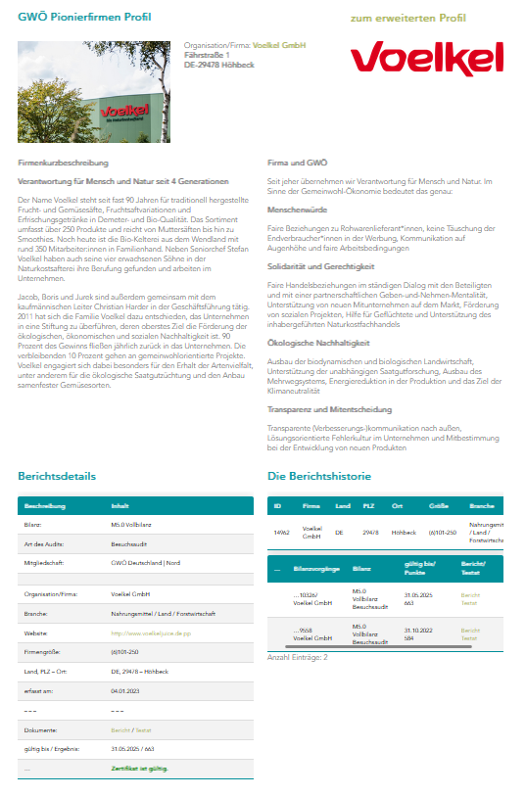
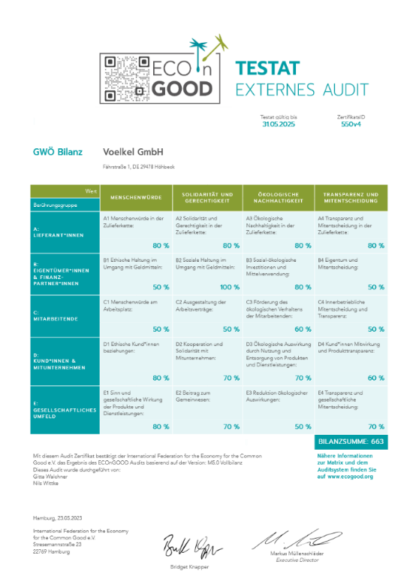
Landing Page | Overview
The QR code provides transparency by leading to a landing page that contains an introduction of the respective organization, its audit report and status of the Common Good Balance Sheet.
Notes:
QR code ensures transparency by leading to a landing page that contains an introduction of the respective organization, its audit report and the status of the common good balance sheet.
Audit tool of central importance - the pivotal point! Great thank you going out to Roland!

Slide 21
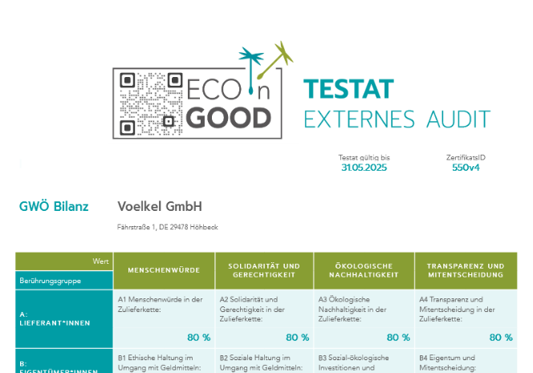
Landing Page | Validity
Status
When the audit report is no longer valid, the landing page will display the following message:
The ECOnGOOD audit report expired on dd/mm/yyyy.
Please contact the organization to update their ECOnGOOD audit.
Notes:
Status of CG Balance Sheet clearly visible

Slide 22












Pilot Organizations
THANK
YOU!
Caritasverband für die Stadt Köln e.V.
Fahnen-Gärtner GmbH
inoio gmbh
Prior1 GmbH
PROSA Architektur und Stadtplanung
Raiffeisenbank Lech am Arlberg
TRESS Lebensmittel GmbH & Co. KG
Voelkel GmbH
WEtell GmbH
Notes:
Pilotphase 2023
Wanted international orgs., unfortunately none fulfilled all requirements

Slide 23
OrganiZations need to have
Currently valid audit report
Positive result of the Common Good
Balance Sheet
Registered in the audit database
Member of an ECG association
Who Receives the Label?
Notes:
To receive label and in particular to keep it, companies to update their CGBS regularly. Majority of orgs have expired CGBS

Slide 24
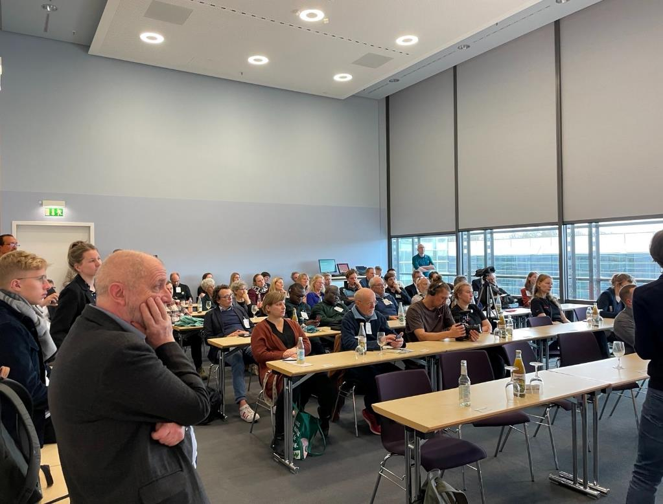
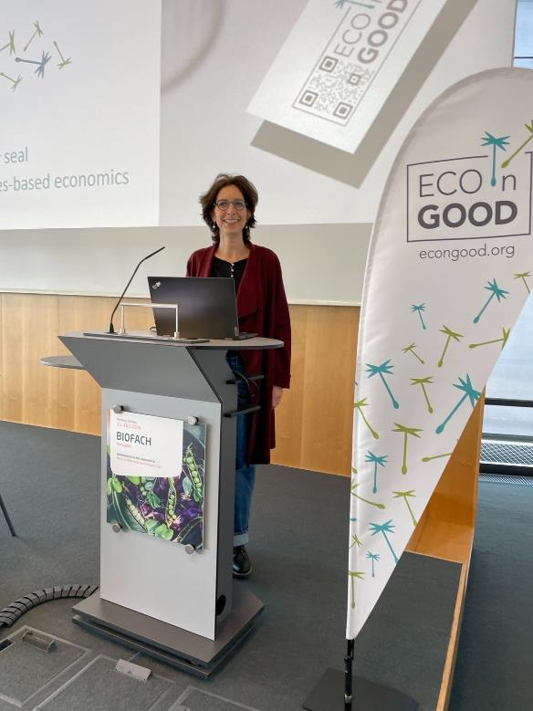
Launch at BIOFACH | February 15, 2024
Large audience
Very interested
Positively received
Notes:
https://www.youtube.com/watch?v=cvBVgoPqYLs
Length of stay
Bernward Geier (has been active in the field of agricultural and environmental policy, the media and lecturing and presenting in over 100 countries for more than 45 years.),
Reps of ECOnGOOD companies: didn‘t want to come here, who in the world needs yet another label, now totally convinced, this is great!

Slide 25
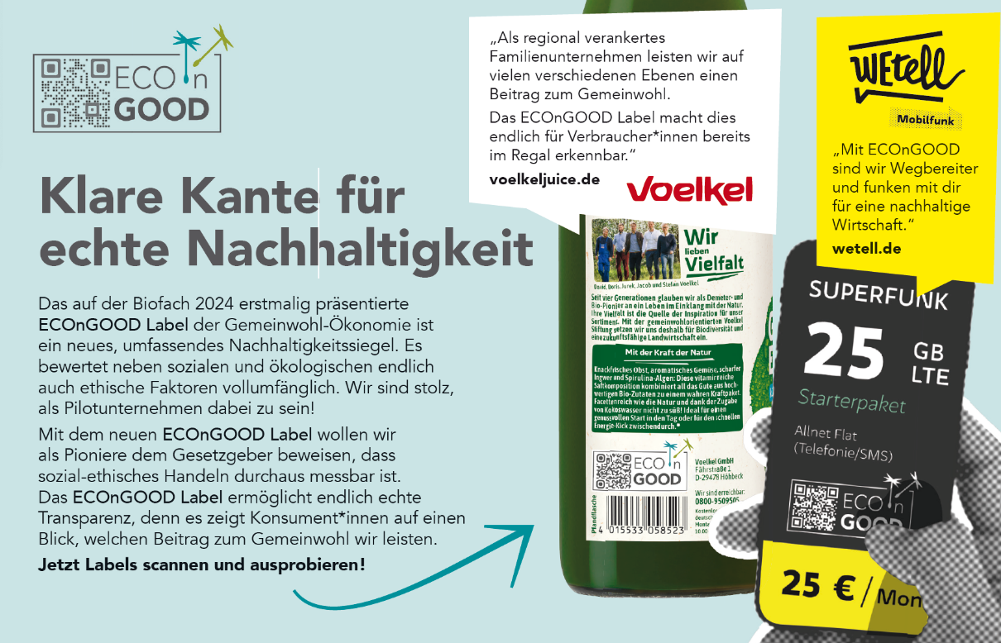
First Advertisement | Schrot & Korn, March 2024
Notes:
Now inform everyone together through SM

Slide 26
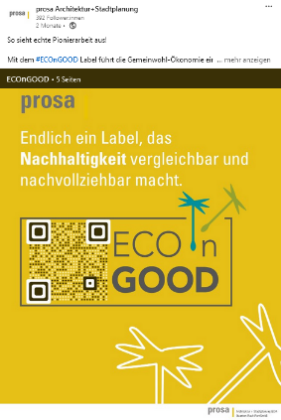
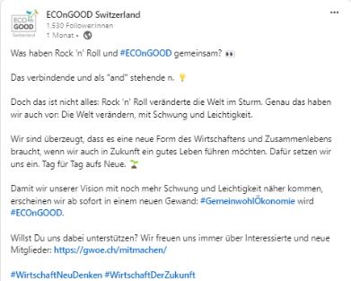

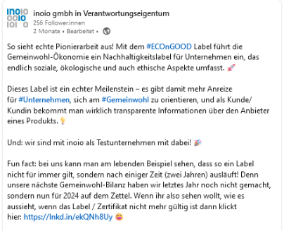
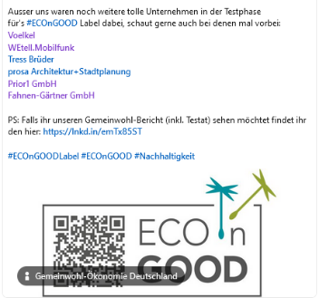
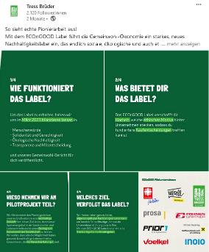
Social Media | Some Examples
Notes:
Prosa Architektur, inoio, Tress Brüder, CH play on words

Slide 27
The Label…
… makes all facets of sustainability measurable and comparable
… creates trust through high level of transparency
… increases attention for sustainability and ethical values
… attracts buyers, investors and new employees
  Advantages | For All
Notes:
A uniform label for all – social, ethical values can be measured and compared – important step towards a uniform standard of sustainability

Slide 28
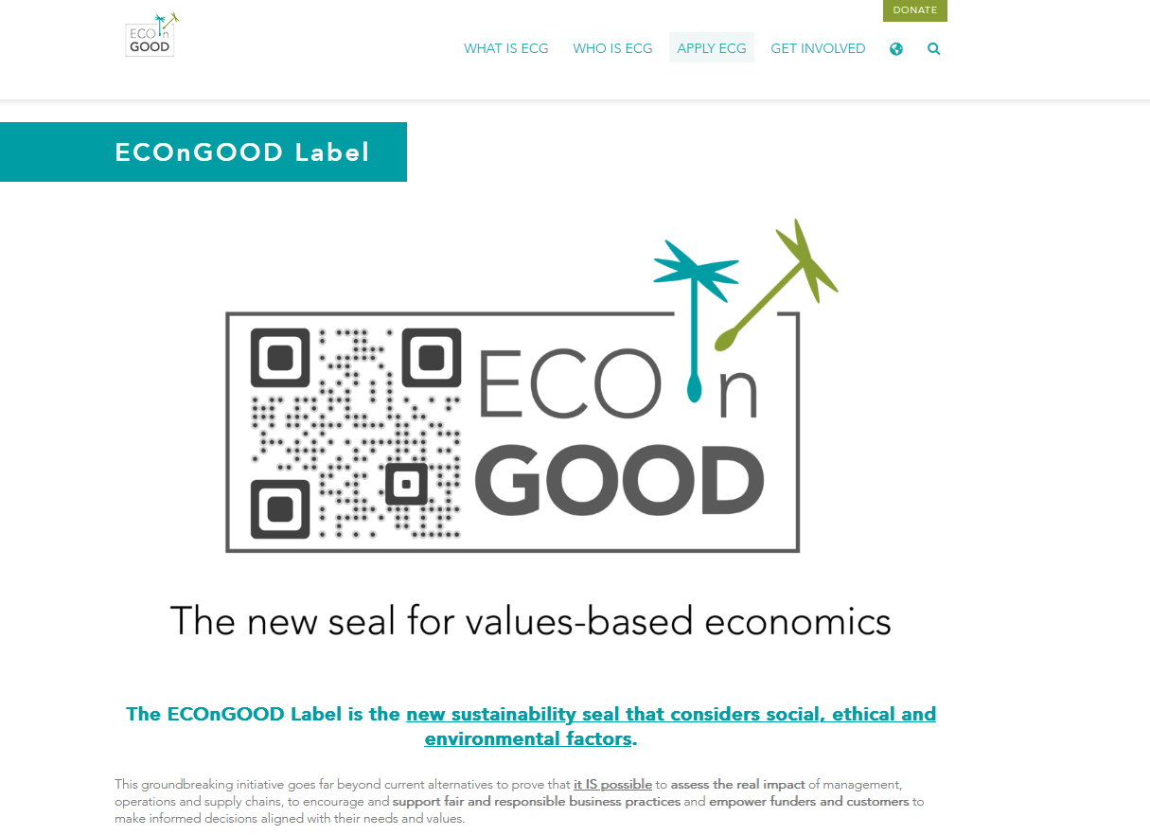
ECOnGOOD Label | Website
https://www.ecogood.org/apply-ecg/econgood-label/
Notes:
External Info

Slide 29
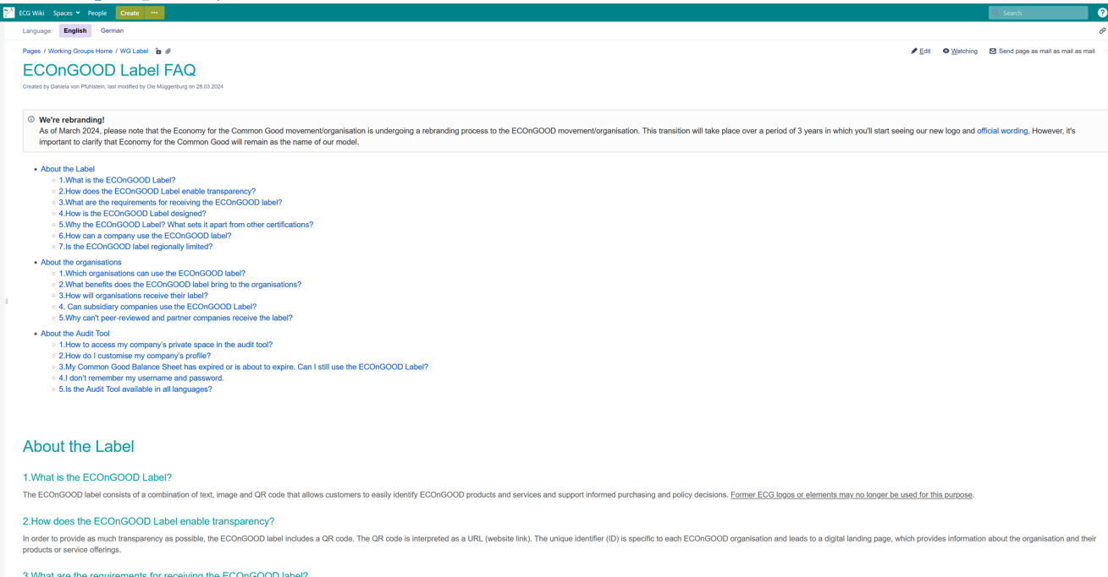
Label FAQ
https://wiki.ecogood.org/x/sgE9F
Notes:
Internal Info

Slide 30
Network Signs
04

Slide 31











Initial Situation
Notes:
Who gets what?

Slide 32

The Solution | Versatile
Complexity significantly reduced
Affiliation clearly recognizable
VISUALLY
The seedlings are used in all applications
TEXT
We support ECOnGOOD
Phase-In
We support the idea of the Economy for the Common Good
I support ECOnGOOD
Phase-In
I support the idea of the Economy for the Common Good
TEXT
Instructions in new CD Manual
Notes:
Conserving resources, reducing complexity

Slide 33

The Solution | For diverse Applications
Final version
Phase-In
I support
ECOnGOOD
I support the idea of the
Economy for the Common Good
We support
ECOnGOOD
We support the idea of the
Economy for the Common Good

Slide 34
Suggestion | For Organizations with Peer-Balance
Based on suggestion made during the Info Sessions Q1 and Q2 2023
As a consequence the Seedlings have been registered
and protected as a brand since Q4 2023
We work according to the Values of the
Economy for the Common Good

Slide 35
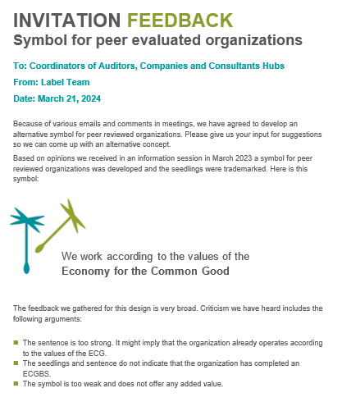
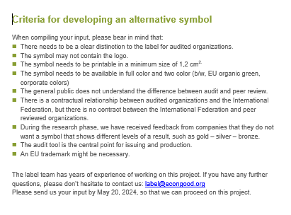
Alternative Concept | Feedback by June 20th
Notes:
Complicated and complex (compact or full balance sheet, peer evaluation or with audit) Membership Supporters

Slide 36
Introduction Rebranding
05

Slide 37

Branding | International
According to the decision of the Delegates Assembly 2020
Introduction of the new logo parallel to the label.
An interim solution will be offered: for three years, the new branding can be used with the addition of the former name.
Part of the phase-In
Notes:
Ideally directly new logo
Three years introductory phase

Slide 38









Branding | Associations, Local Chapters and Hubs
+ appropriate addition

Slide 39
Branding
Chile
Österreich
Steiermark
Region Weiz
Recommendation Graphic
Uniform use of the main logo is the best solution!
Romandie
Zagreb
Basel
Notes:
IF – Nat. associations – reg. associations – LC
Conditions & Timetable for Label, Logo & Seedlings Usage: https://wiki.ecogood.org/x/CAANGQ
Komms Teams DACH bieten an zu übernehmen

Slide 40
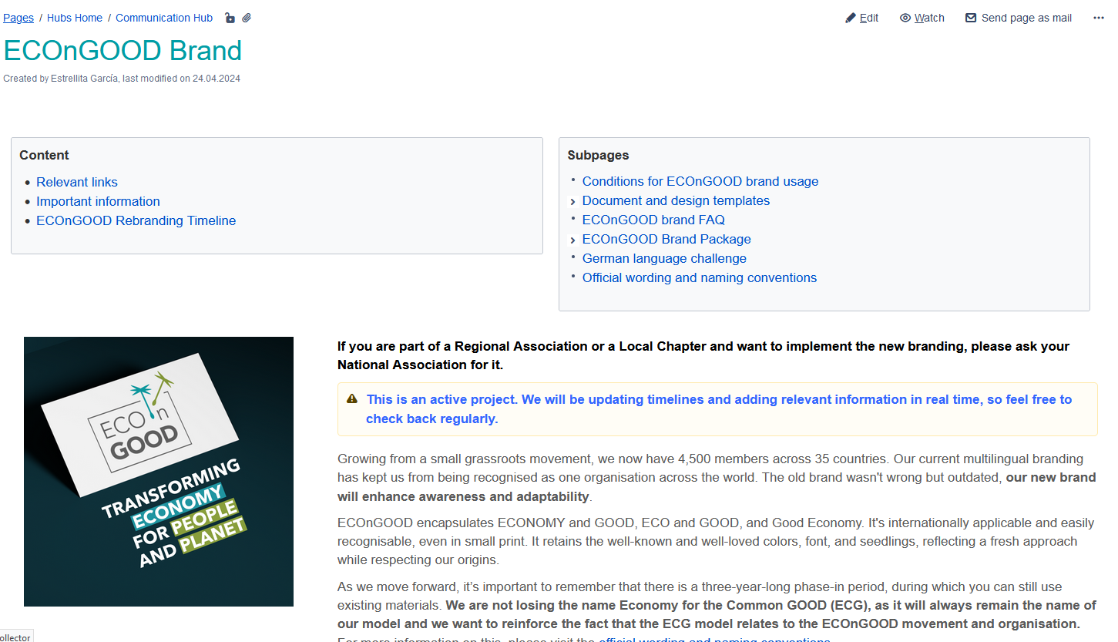
Detailed Informationen
https://wiki.ecogood.org/x/TACnGQ
Notes:
Humangous thank you to Estrellita!
Das Material wird auf Deutsch bald erhältlich sein

Slide 41

The New CD Manual
file:///C:/Users/danie/Downloads/ECOnGOOD_2024_Manual.pdf

Slide 42
Material to be Used
Templates for various applications have been created
PowerPoint Präsentation
Flyer
Poster
Beachflag
General text document
Presse Release
Letterhead
and many more
https://wiki.ecogood.org/x/tYDnGQ

Slide 43
Wording | Terminology and Phrasing
Status Quo | Neu
The idea / model of the Economy for the Common Good (Felber, 2010) | The idea / model of the Economy for the Common Good (Felber, 2010)
The movement Economy for the Common Good | The movement Economy for the Common Good (ECOnGOOD)
The organization (legal name): International Federation for the Economy for the Common Good e.V | The organization: International Federation for the Economy for the Common Good e.V also known as ECOnGOOD
Common Good Matrix | Common Good Matrix
Common Good Balance Sheet | Common Good Balance Sheet
Common Good Product | Common Good Product
Common Good Index | Common Good Index
Common Good Audit | ECOnGOOD Audit
Common Good Report | ECOnGOOD Report
Common Good Certificate | ECOnGOOD Certificate
Common Good Auditor / Consultant | ECOnGOOD Auditor / Consultant
Ecogood Business Canvas | ECOnGOOD Business Canvas
ECG Company / Organization | ECOnGOOD Company / Organization
Common Good Municipality | ECOnGOOD Municipality
Part of the Phase-In
https://wiki.ecogood.org/x/dIDnGQ

Slide 44


ECOnGOOD | Logo vs. Label
What is our new logo?
This is our branding
For official communication of the organization
Associations
Local Chapters
Hubs
WHat is our label?
This will be our seal
For communication of audited organizations
Products
Services
External communications

Slide 45
Thank you
For your attention
Questions?

