Slide 1
ECONGOOD CONFERENCE 2024
DELEGATES ASSEMBLY 2024
20-22 June 2024

Slide 2
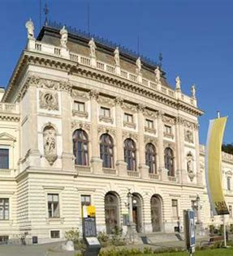
Sovereign
Democracy
Voting
Method developed by the University of Graz.
Every rule (existing or alternative) restricts the liberty of citizens.
What causes the least pain in the overall population.
Restricts liberty in the least possible degree
Photo by Dex Ezekiel on Unsplash
www.econgood.org |
2
Notes:
The voting process we use within ECOnGOOD is sovereign democracy
This is a method developed by the University of Graz
Scholars at the university realised that every rule (existing or alternative) restricts the liberty of citizens and causes pain in the population
This procedure from the University of Graz, finds the rule that causes the least pain in the overall population and restricts liberty in the least possible degree

Slide 3
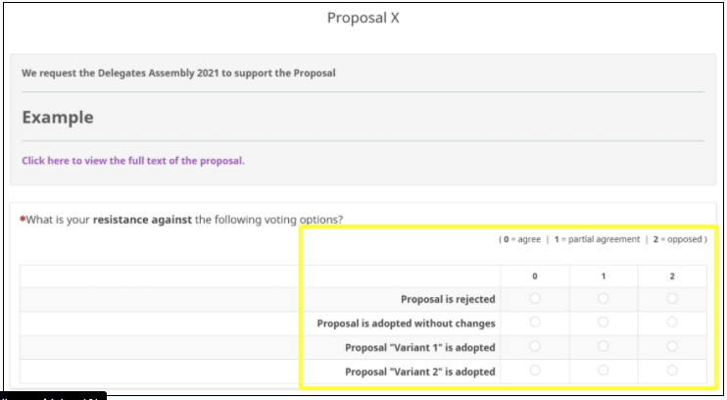
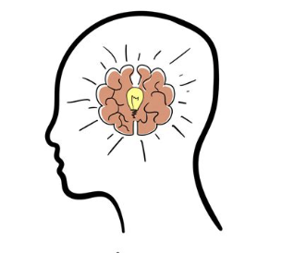

Vote from the heart and connect with any resistance
Read the
PROPOSAL
Connect with your
INTUITION
Listen to your
HEART

Slide 4
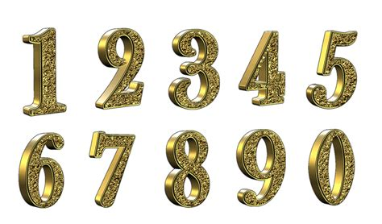



No PAIN = No RESISTANCE
SOME PAIN = SOME RESISTANCE
STRONG PAIN = HIGH RESISTANCE
agree
accept the option
partial agreement
can live with it
oppose
reject this option
Notes:
Voting is open now and remains open until 10pm tonight.
All the votes are then counted and the option with the least resistance goes through
If there is strong resistance to any proposal, then the proposal is not passed.
Voting results will be published tomorrow

Slide 5
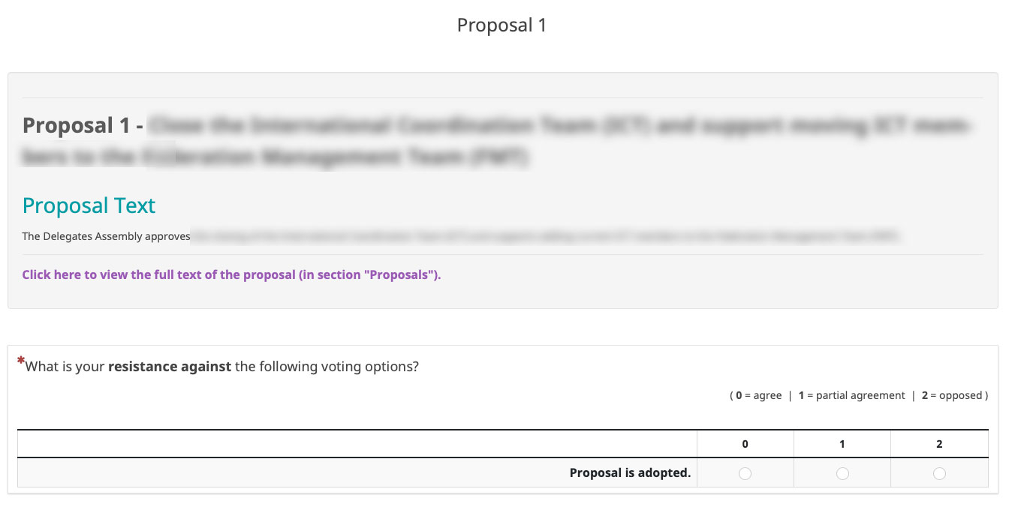
Voting remains open until 22.00 (CEST)
Delegates can save, change and resubmit their votes at any point up to 22.00
When polls close, the submitted votes will count as the final vote
Notes:
All delegates have a chance to vote today and should receive an email with the lime survey link
Voting for proposals is by name / Voting for ICT members is anonymous
Results will only be shown in a generalized manner

