Slide 1

Organizational Development ECONGOOD
A progress update

Slide 2
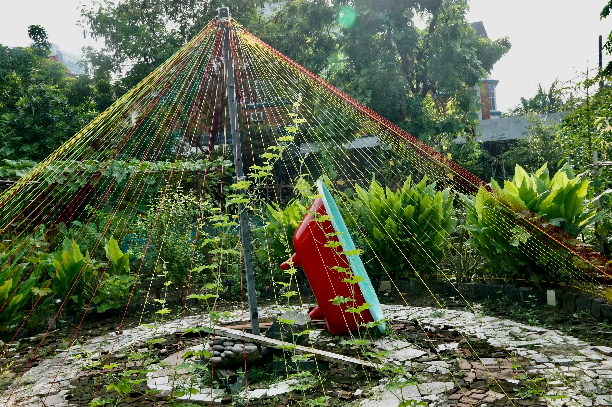
The Challenge
Pioneering Phase
The vision excites many
The initiative comes from individual key stakeholders
The organization grows
Internal decision-making paths are unclear
Communication channels are unclear
Transition to the Differentiation Phase
Organizational division of tasks
Defined roles with delegated authority
Clear alignment and priorities
Conservation of resources, pooling of strengths
Effectiveness and impact

Slide 3




Introduction: Similarities & Challenges
Pressure, resource scarcity, too many WG’s, and a lack of structural and role clarity.
The projects have the same objectives.
All are developing similar structures.
Solutions and outlooks are alike.

Slide 4
Decision from Delegates Assembly
DA-decision Nr 9/2023
A working group should develop a proposal for re-structuring the ECG towards a sociocratic model.
The re-structuring should improve the quality of decisions and communication and optimize the management of resources throughout the movement.
To check the feasibility of the new structure, parts can already be tested, incorporating collected feedback from relevant groups in the ECG and experts in sociocracy. Such as the so-called “External Services” circle, which has already been signed off by the FMC and will be launched in the near future.
At the next DA, the proposal for re-structuring the ECG should be presented including feedback from the pilots.

Slide 5
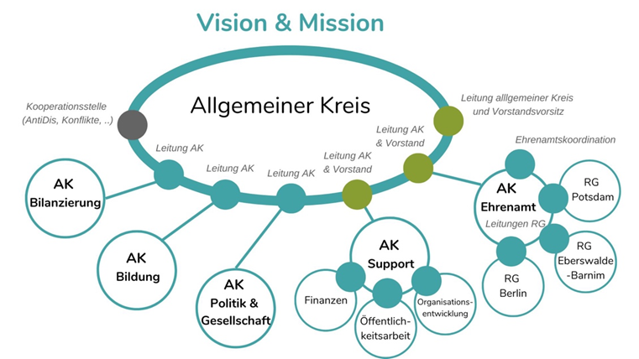
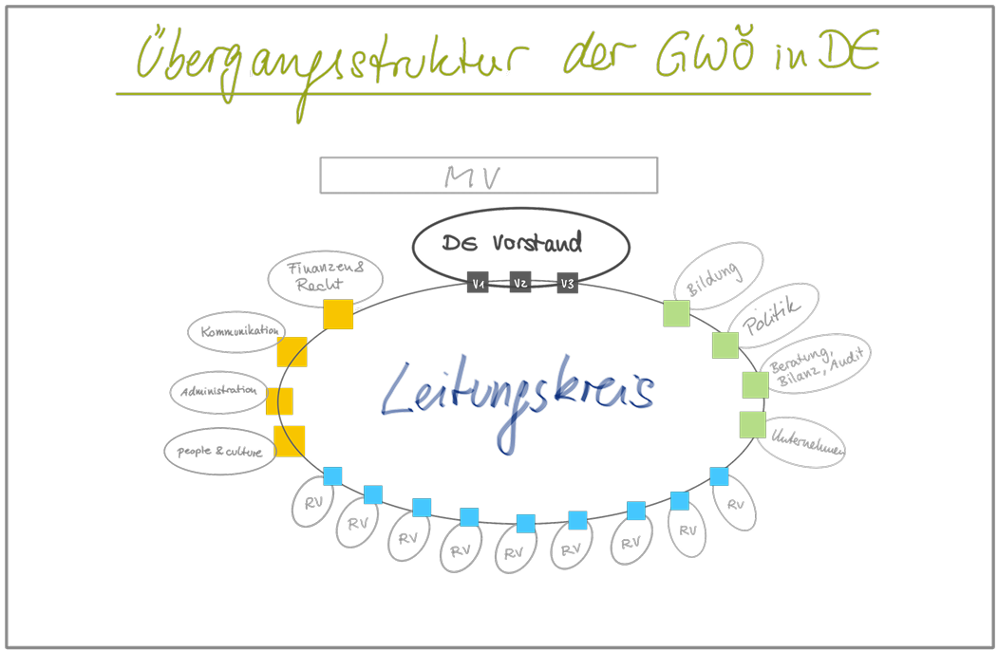
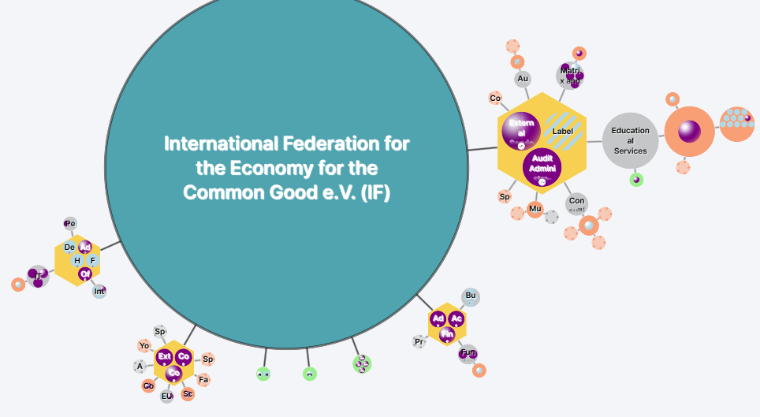
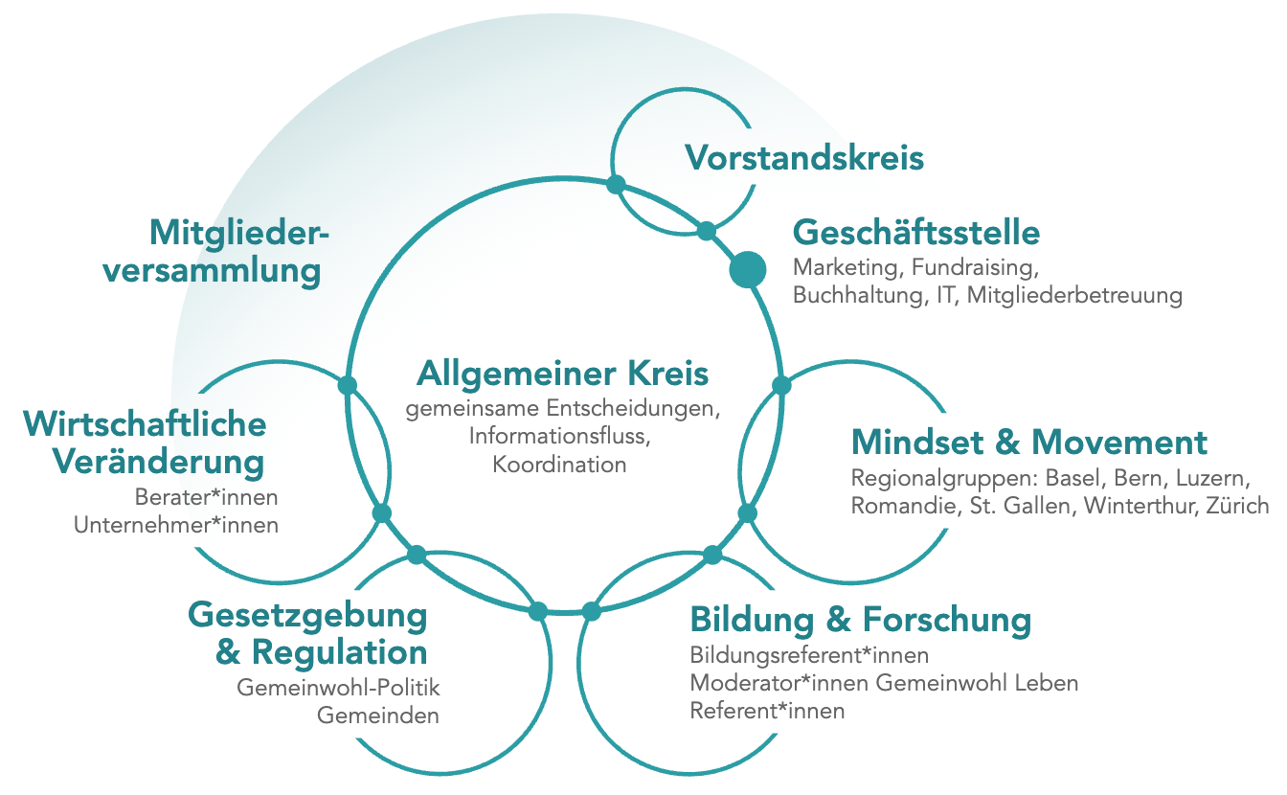
Cross-organizational development within the ECG
New structures are emerging in various areas of the ECG
The focus is on (1) structures and (2) sociocracy – in different forms
Things are coming together well
We are approaching a positive tipping point
RV Berlin-Brandenburg
Quelle: Peerdom

Slide 6
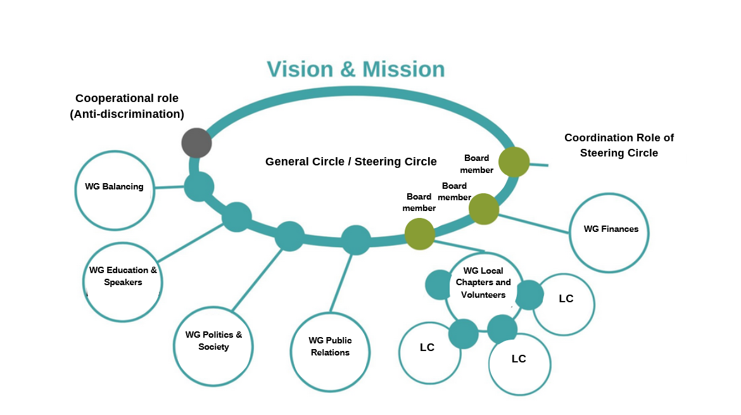
Experience from Regional Association Berlin- Brandenburg Reorganisation 2021
Notes:
Text gesprochen….. Maria

Slide 7
Sociocratic circle structure / organisation chart
Management Board
General Assembly
office
General circle
Joint decisions, information flow, coordination
Economic change
Education & Research
Legislation & Regulation
https://econgood.ch/ueber-uns/
Notes:
Die bisherigen aussenwirksamen Fokusgruppen und die Regionalgruppen sind in vier gleichberechtigte Wirkungsbereiche zusammengefasst.
Die Wirkungsbereiche bilden in doppelter Kopplung zusammen mit der Geschäftsstelle und Vorstandsdelegation den allgemeinen Kreis.
Die Wirkungsbereiche sind selbstorganisiert innerhalb der gemeinsam abgestimmten Domänen.
Der Vorstand übernimmt die strategische Führung und die Sicherung der rechtlichen Vereinsstruktur.
In der Geschäftsstelle sind alle Supportfunktionen zusammen gefasst.
Alle Vereinstätigkeiten sind einer passenden Einheit zugeordnet.
Webseite kurz durchscralen.

Slide 8

"The STRONG process aims to bring the GWÖ in Germany to its greatest effectiveness through suitable framework conditions, enabling both full-time and volunteer staff to experience joy and impact in their work."
GOAL OF STRONG
Notes:
Ziel

Slide 9
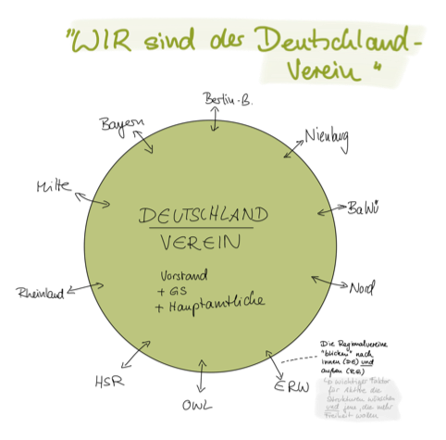
Notes:
Zusatz zum Kulturthema.

Slide 10
Transitional Structure of the GWÖ Movement in Germany
Proposal from the Project Team & Adjustments
Notes:
Erkenntnisse / Learnings

Slide 11



Slide 12
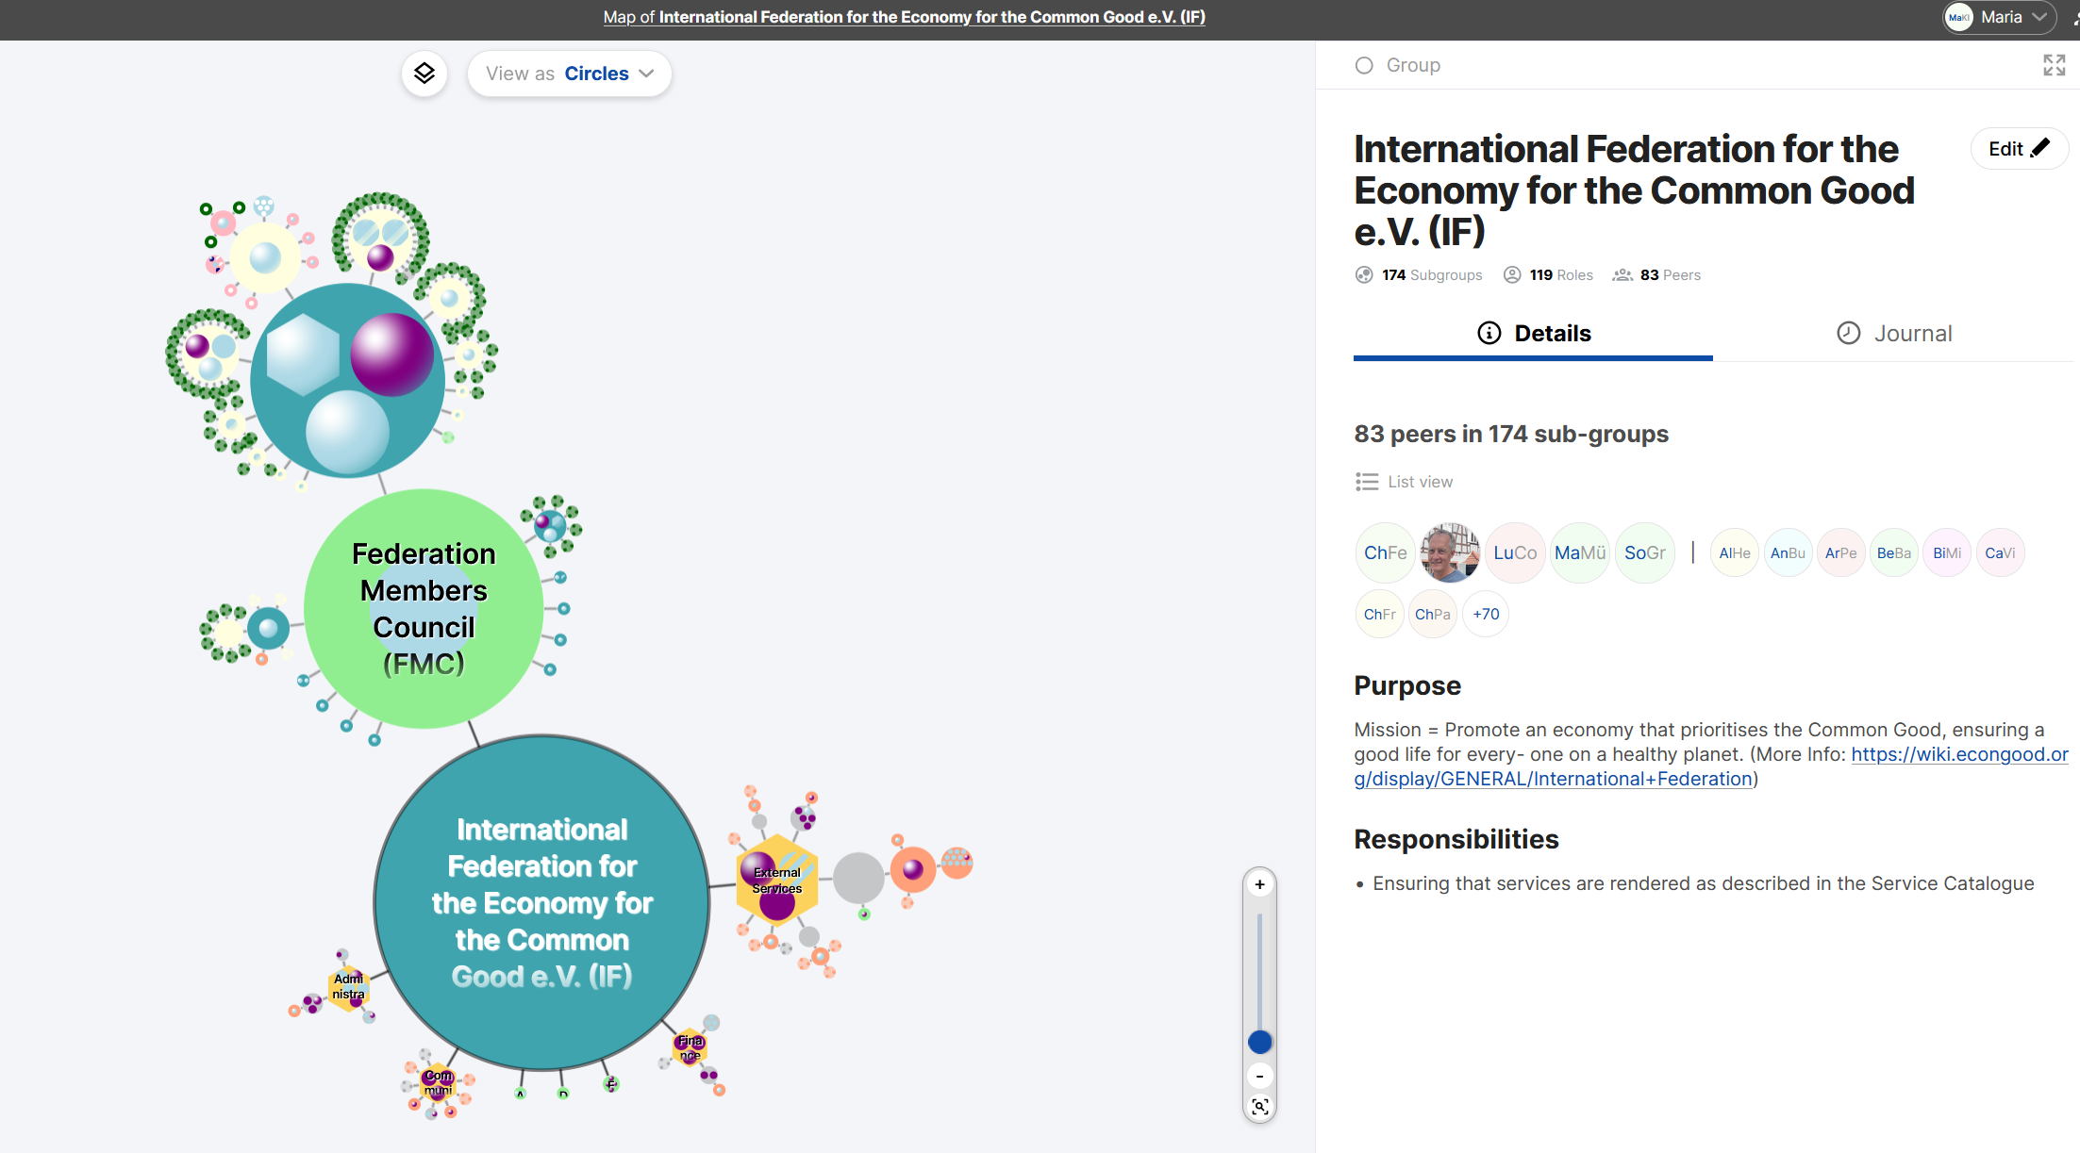
Peerdom Map of the International Federation (Prototype) „We are all organised inside of the IF“

Slide 13
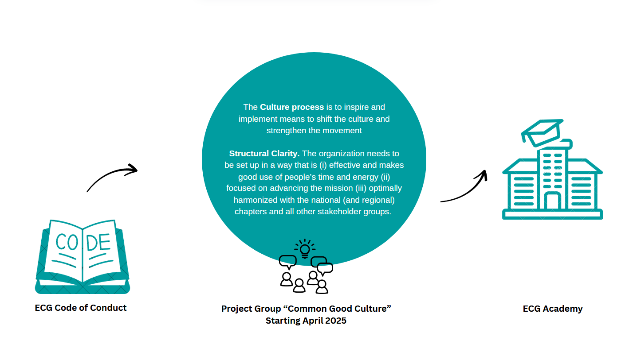
Common Good Culture Project – IF

Slide 14
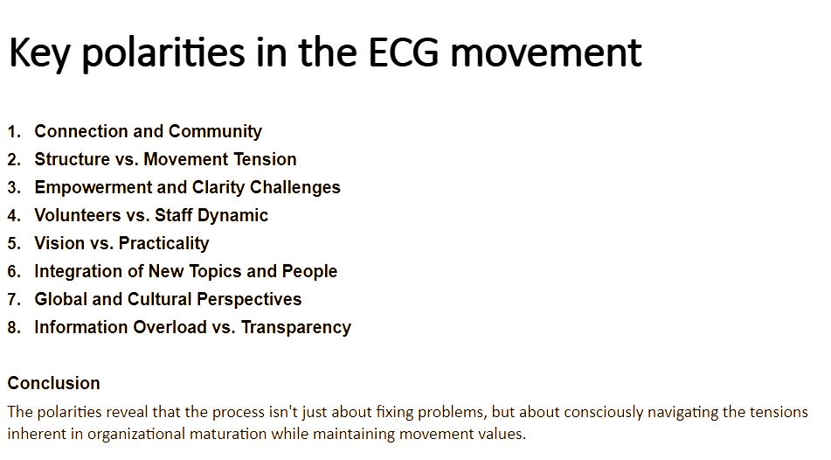

Slide 15
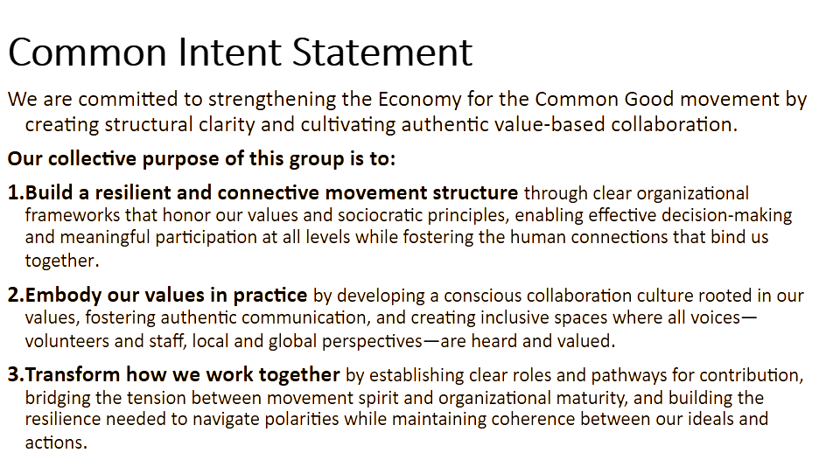

Slide 16
Let’s bring our organisation to the next level!

