Slide 1





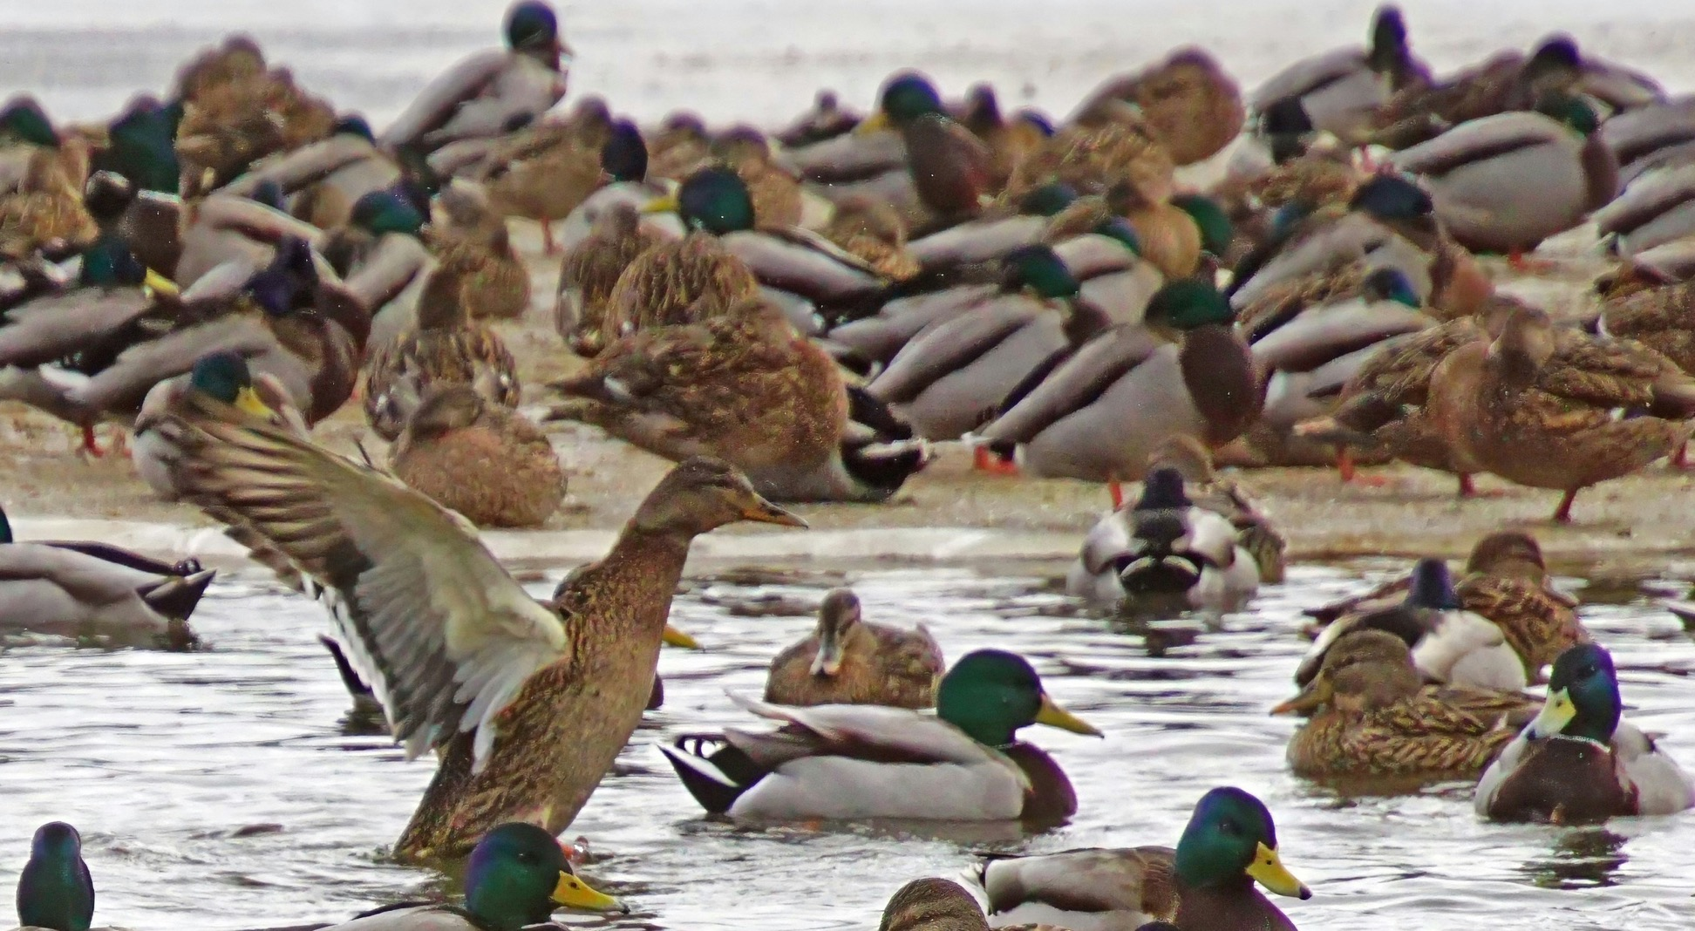







Chance to Network
All rooms will close at 21:00 cet
Have fun building deep and meaningful connections
Photo by Martti Salmi on Unsplash

